Slide 1

Timing, quality of care, & agency: women’s abortion trajectories & outcomes
Rishita Nandagiri
r.nandagiri@lse.ac.uk
@rishie_
Supervisors: Prof. Ernestina Coast & Dr Tiziana Leone

Slide 2
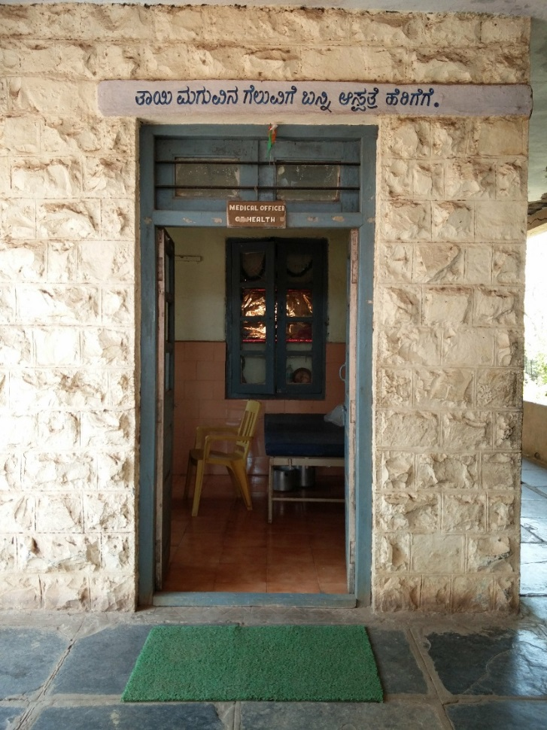
Introduction
Part of larger study investigating women’s abortion and abortion-related experiences.
This paper investigates women’s (n=31) trajectories to abortion access, care, & self-described outcomes; in relation to current abortion safety classifications.
Women’s trajectories to abortion access & care shape the kind of access & care they receive, impacting safety & outcomes.

Slide 3
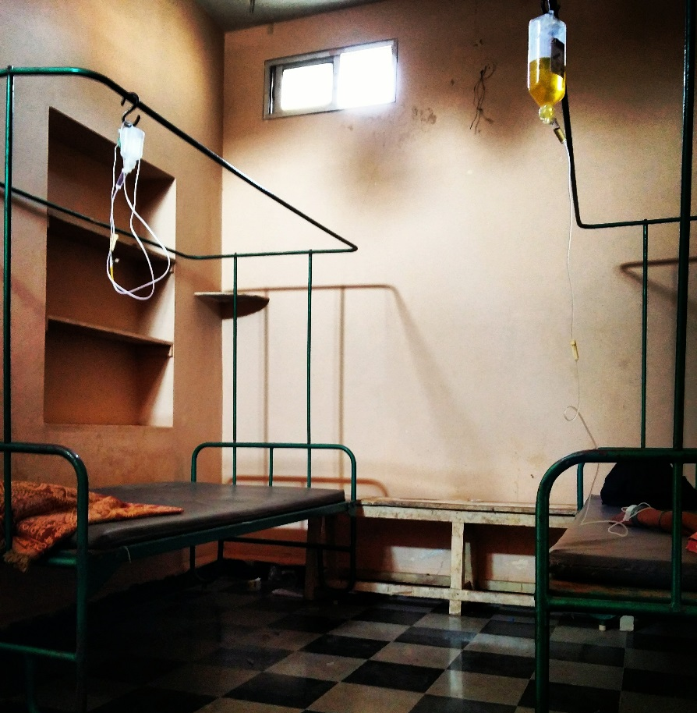
Conceptual Framework
- Women’s abortion care-seeking is non-linear, complex, & involves multiple steps.
- Influenced by knowledge of laws/methods, abortion stigma, social support, disclosure/secrecy.
- Coast et al.’s (2018) socio-ecological model accounts for the multiple, intersecting levels & domains affecting access

Slide 4
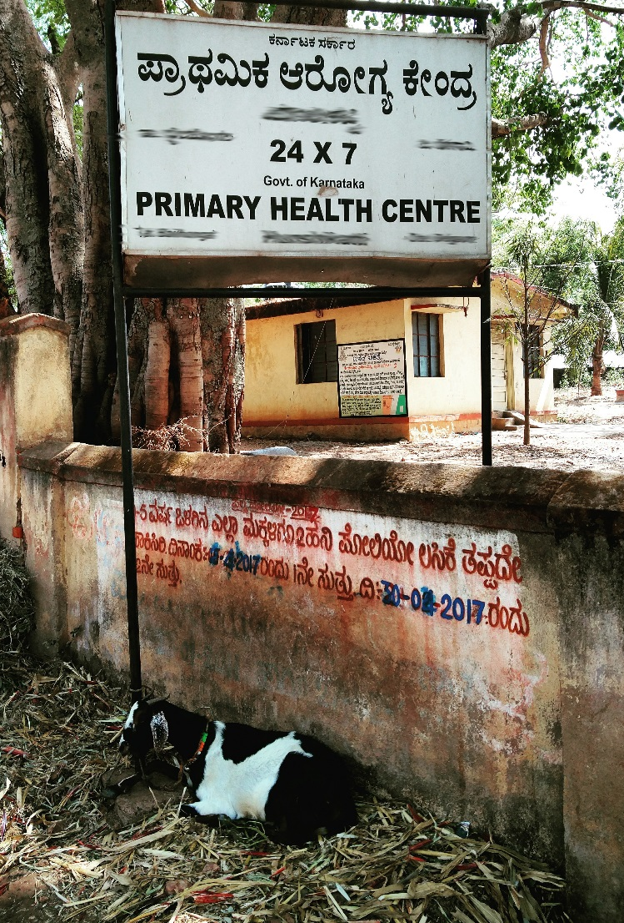
Abortion Context
- MTP Act (1971) – available under broad grounds.
- Only trained & registered practitioners and specialists, in registered or authorised clinics permitted to provide abortion services.
- Medication abortion (MA) approved up to 7 weeks*

Slide 5
Methodology
In-depth interviews with women (n=31) within three weeks of their abortion.
Recruitment through Community Health Workers (CHWs), verified against an existing population registry- the Maternal Newborn Health Registry (MNHR).
Hybrid thematic analysis (Fereday et al., 2006), using conceptual framework for deductive analysis.
Ethics approval in country + LSE

Slide 6
Abortion Method
Abortion method | Sample distribution (n=31)
Self-managed MA* | 12
MA through formal services (public and private) | 6
MA* followed by D&C/E (public and private) | 4
Surgical abortion (public and private, D&C/E) | 9

Slide 7
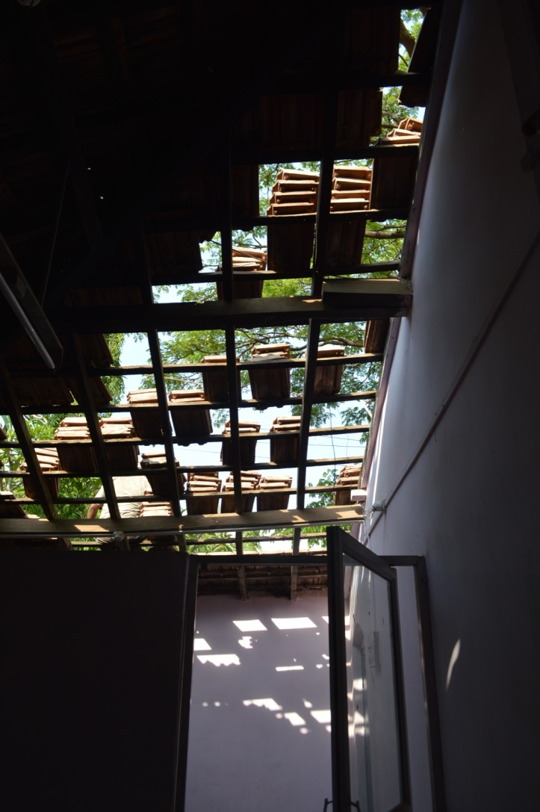
Case Study 1: Pragnya
Age 16, married at 14. One child (18 months)
Pregnancy confirmation: six weeks via UPT
Abortion obtained: 17 weeks
Delay: 11 weeks
Abortion method: D&C, private clinic
Self-reported outcomes: Abdominal pain & cramping, pain, nausea, fever, bed rest, disruption to daily routine, reduced physical activity, weakness.

Slide 8
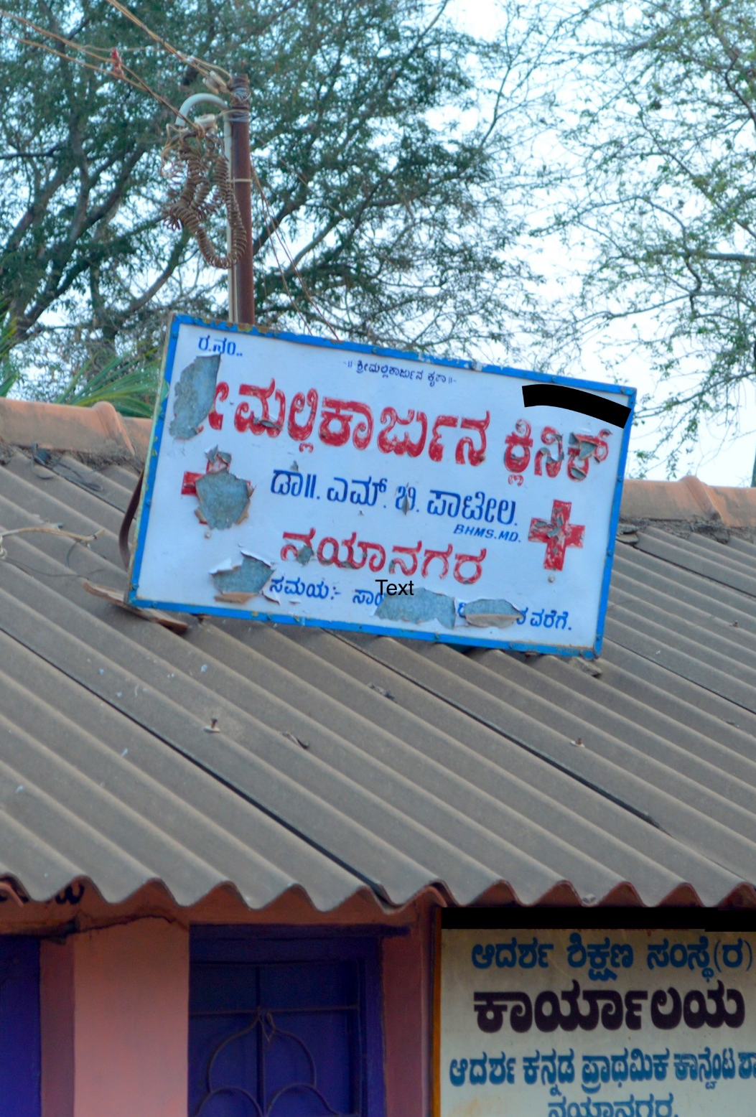
Case Study 2: Qabila
Age: 22, married, one child (11 months).
Pregnancy confirmation: six weeks via UPT
First abortion attempt: seven weeks, MA through untrained provider. Spotting, incomplete abortion
Delay: 6 weeks
Abortion obtained: 13 weeks
Abortion method: D&C, private clinic.
Self reported outcomes: some bleeding, cramping, & fever

Slide 9
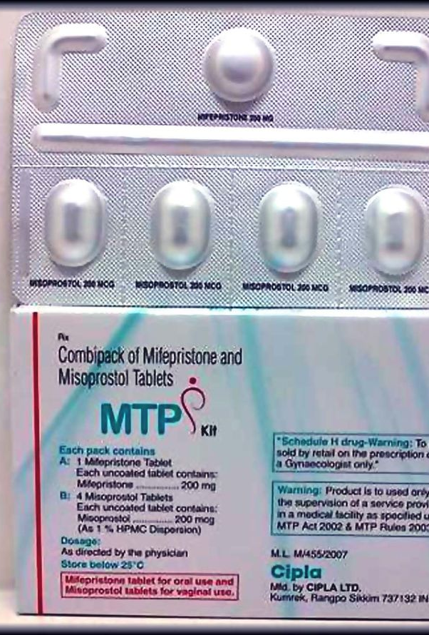
Case Study 3: Janani
Age: ±40, married, three children.
Pregnancy confirmation: six weeks via UPT
Abortion obtained: seven weeks
Abortion method: self-managed MA
Self-reported outcomes: none

Slide 10
Gestational age
Confirmation of Pregnancy
5-8 weeks (n=19)
9-12 weeks (n=7)
13-14 weeks (n=2)
15-18 weeks (n=2)
19-22 weeks (n=1)
Abortion obtained
5-8 weeks (n=10)
9-12 weeks (n=12)
13-14 weeks (n=3)
15-18 weeks (n=3)
19-22 weeks (n=3)
D&C/E
MA formal
MA followed by D&C/E
Self managed MA

Slide 11
Pregnancy Confirmation, Abortion Timing, & Method
Gestational age | Confirmation of pregnancy (n=31) | Abortion obtained (n=31) | Abortion Method
5-8 weeks | 19 | 10 | MA (formal): 1
 |  |  | Self-managed MA: 8
 |  |  | D&C/E: 1
9-12 weeks | 7 | 12 | MA (formal): 1
 |  |  | MA followed by D&C/E:1
 |  |  | Self-managed MA: 6
 |  |  | D&C/E: 4
13-14 weeks | 2 | 3 | MA followed by D&C/E: 1
 |  |  | D&C/E: 2
15-18 weeks | 2 | 3 | MA (formal): 2
 |  |  | D&C/E: 1
19-22 weeks | 1 | 3 | MA followed by D&C/E: 1
 |  |  | D&C/E: 1

Slide 12
Pregnancy Confirmation, Abortion Timing, & Method
Gestational age | Confirmation of pregnancy (n=31) | Abortion obtained (n=31) | Abortion Method
5-8 weeks | 19 | 10 | MA (formal): 1
 |  |  | Self-managed MA: 8
 |  |  | D&C/E: 1
9-12 weeks | 7 | 12 | MA (formal): 1
 |  |  | MA followed by D&C/E:1
 |  |  | Self-managed MA: 6
 |  |  | D&C/E: 4
13-14 weeks | 2 | 3 | MA followed by D&C/E: 1
 |  |  | D&C/E: 2
15-18 weeks | 2 | 3 | MA (formal): 2
 |  |  | D&C/E: 1
19-22 weeks | 1 | 3 | MA followed by D&C/E: 1
 |  |  | D&C/E: 1

Slide 13
Pregnancy Confirmation, Abortion Timing, & Method
Gestational age | Confirmation of pregnancy (n=31) | Abortion obtained (n=31) | Abortion Method
5-8 weeks | 19 | 10 | MA (formal): 1
 |  |  | Self-managed MA: 8
 |  |  | D&C/E: 1
9-12 weeks | 7 | 12 | MA (formal): 1
 |  |  | MA followed by D&C/E:1
 |  |  | Self-managed MA: 6
 |  |  | D&C/E: 4
13-14 weeks | 2 | 3 | MA followed by D&C/E: 1
 |  |  | D&C/E: 2
15-18 weeks | 2 | 3 | MA (formal): 2
 |  |  | D&C/E: 1
19-22 weeks | 1 | 3 | MA followed by D&C/E: 1
 |  |  | D&C/E: 1

Slide 14
Pregnancy Confirmation, Abortion Timing, & Method
Gestational age | Confirmation of pregnancy (n=31) | Abortion obtained (n=31) | Abortion Method
5-8 weeks | 19 | 10 | MA (formal): 1
 |  |  | Self-managed MA: 8
 |  |  | D&C/E: 1
9-12 weeks | 7 | 12 | MA (formal): 1
 |  |  | MA followed by D&C/E:1
 |  |  | Self-managed MA: 6
 |  |  | D&C/E: 4
13-14 weeks | 2 | 3 | MA followed by D&C/E: 1
 |  |  | D&C/E: 2
15-18 weeks | 2 | 3 | MA (formal): 2
 |  |  | D&C/E: 1
19-22 weeks | 1 | 3 | MA followed by D&C/E: 1
 |  |  | D&C/E: 1

Slide 15
Method and Self-Reported Outcomes
 | Self-managed MA (n=12) | MA through formal services (public and/or private) (n=6) | MA followed by D&C/E (public and/or private) (n=4) | Surgical abortion (public and/or private, D&C/E) (n=9)
None | 5 | 2 | n/a | n/a
Abdominal pain & cramping | 3 | 2 | 2 | 5
Pain (aches) | 2 | 3 | 2 | 4
Nausea | 1 | 4 | 1 | 2
Spotting | 3 | 3 | 2 | 3
Excessive bleeding | 1 | n/a | n/a | n/a
Fever | n/a | 1 | 1 | 1
Bed rest | n/a | n/a | 4 | 9
Reduced physical activity | 1 | n/a | 2 | 9
Disruption to daily routine | n/a | n/a | 4 | 9
Other | 6 | n/a | 1 | 2

Slide 16
Points For consideration
Women’s abortion outcomes are not related to the method(s) of abortion alone, but the negotiations & contestations that precede them too.
Delays, caused due to structural, community, or individual-level factors, shape women's trajectories in dramatic ways.
Thus, timing, quality of care, & women's agencies are key considerations for safety of abortion & outcomes.
Thaddeus & Maine (1994) → a three delays model for abortion?

Slide 17
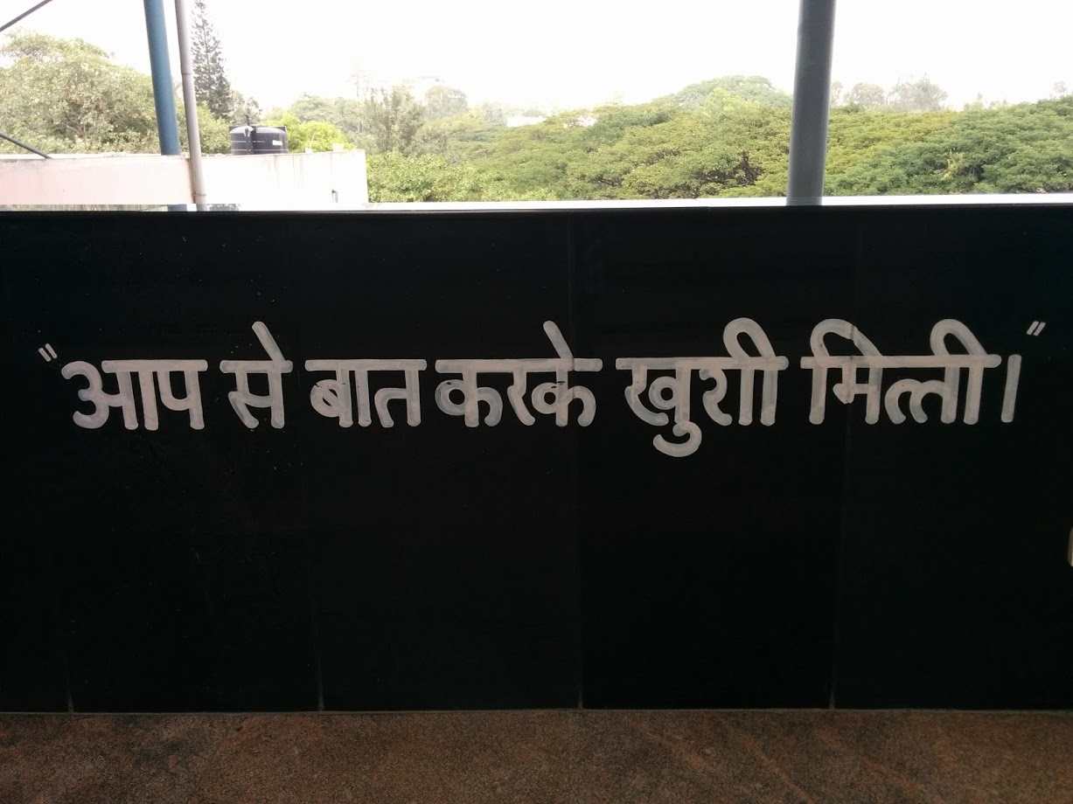


Thank you
(Hindi): Speaking with you was a pleasure.

