Slide 1
Charles Booth’s London: opening up collections on the web
Neil Stewart, Digital Library Manager, LSE Library
booth.lse.ac.uk
Notes:
Hello everyone, Neil Stewart, LSE Library here.
Those of you with computers- please have a look at this URL as I go along…

Slide 2
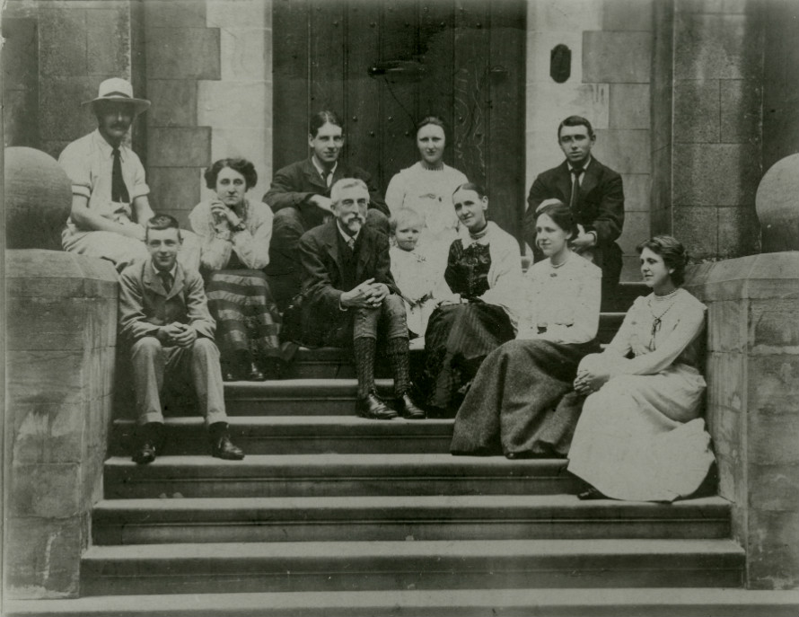
Charles Booth: who?
Notes:
Charles Booth (1840 - 1916): Victorian businessman, philanthropist and social reformer

Slide 3
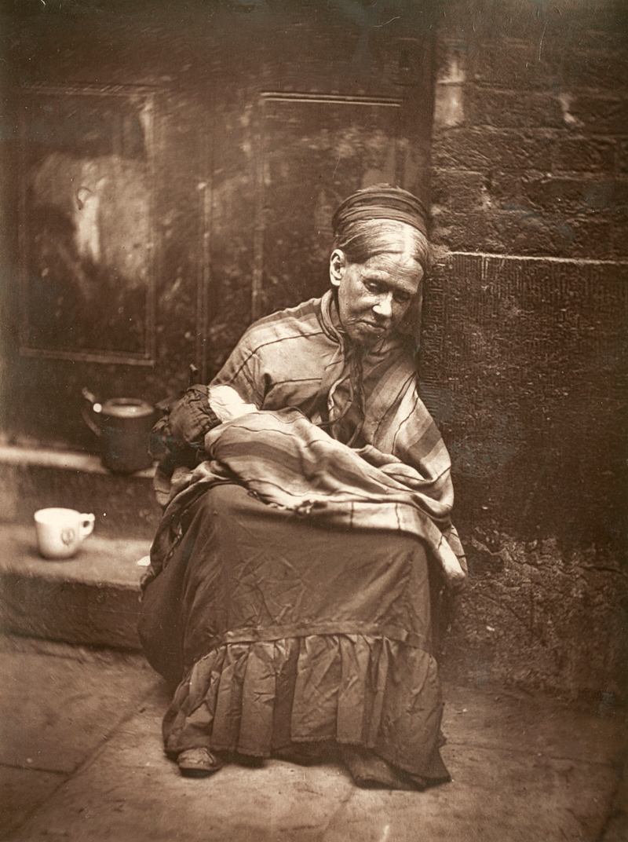
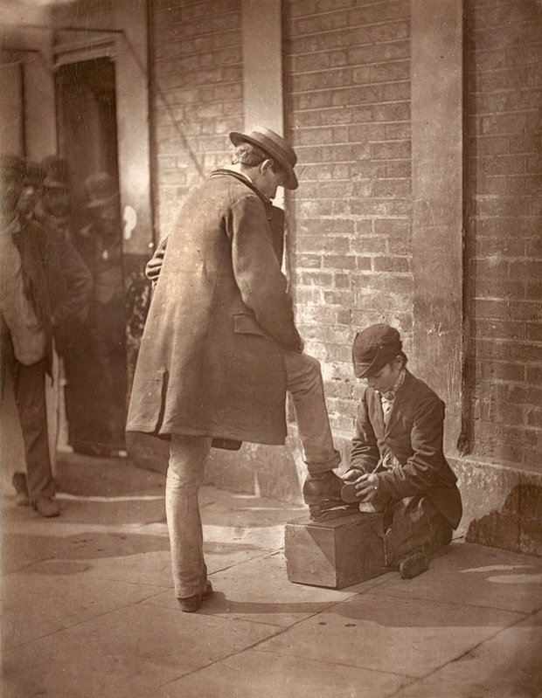
Booth’s project: why, where, when?
The “Crawlers” https://digital.library.lse.ac.uk/objects/lse:zeg943muw; The Independent Shoe Black https://digital.library.lse.ac.uk/objects/lse:tah915quk both CC BY-NC-SA 3.0
Notes:
To discover the level of poverty in Victorian London
Booth disbelieved that poverty was as prevalent as thinkers of the day proposed
His work showed that it was actually much higher – some 30% of people in a city of 6million people lived “below the poverty line”

Slide 4
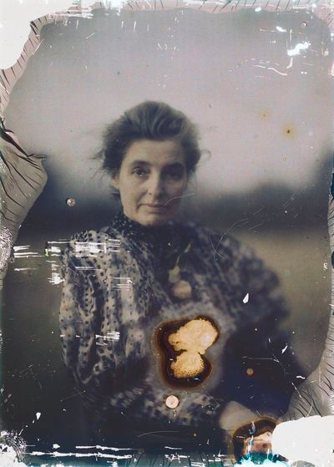
Booth’s project: how?
Beatrice Webb, photographed c. 1910 by GB Shaw
Shaw Photographs https://digital.library.lse.ac.uk/collections/webb G.B.Shaw Estate © G.B.Shaw reproduced by kind permission of the Society of Authors, on behalf of the Bernard Shaw estate.
Notes:
The project team walked the streets of London and talked to people: policemen, school board visitors, religious figures, and the residents and workers themselves
They recorded data, both qualitative & quantitative
Beatrice Webb, co-founder of LSE, was part of the team

Slide 5
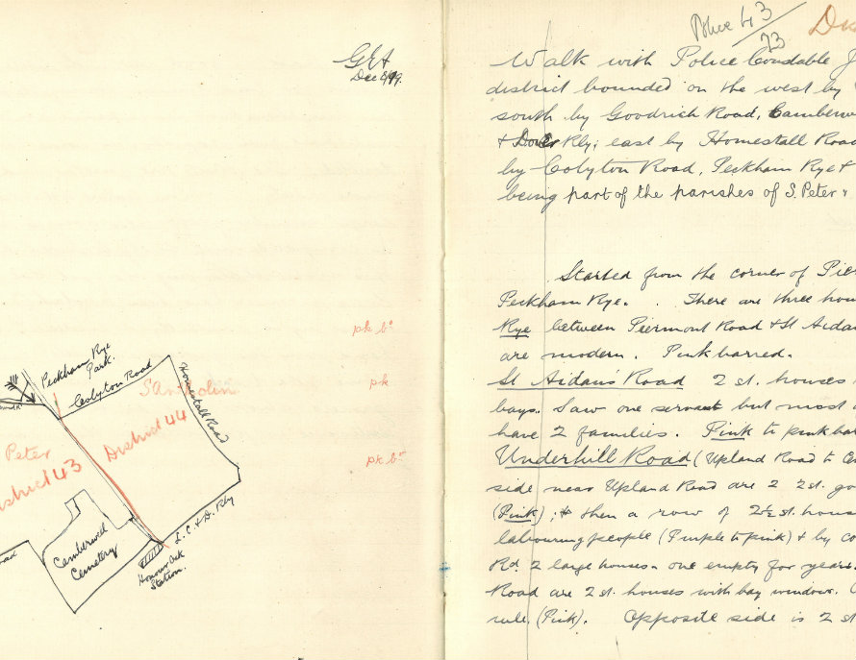
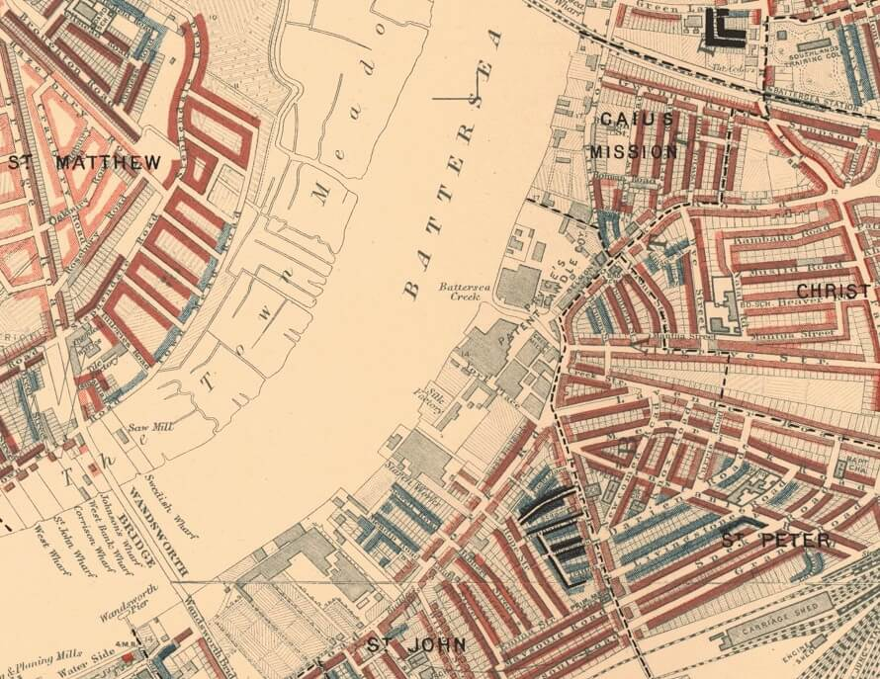
Booth’s project: what?
Notes:
So what was produced? Full archive held at LSE Library- jewel in the crown. Of note for this presentation:
Poverty maps (12 individual maps)
Notebooks, inc. the Police Notebooks. Important to note that the Police Notebooks relate to particular areas and so are amenable to geolocation

Slide 6
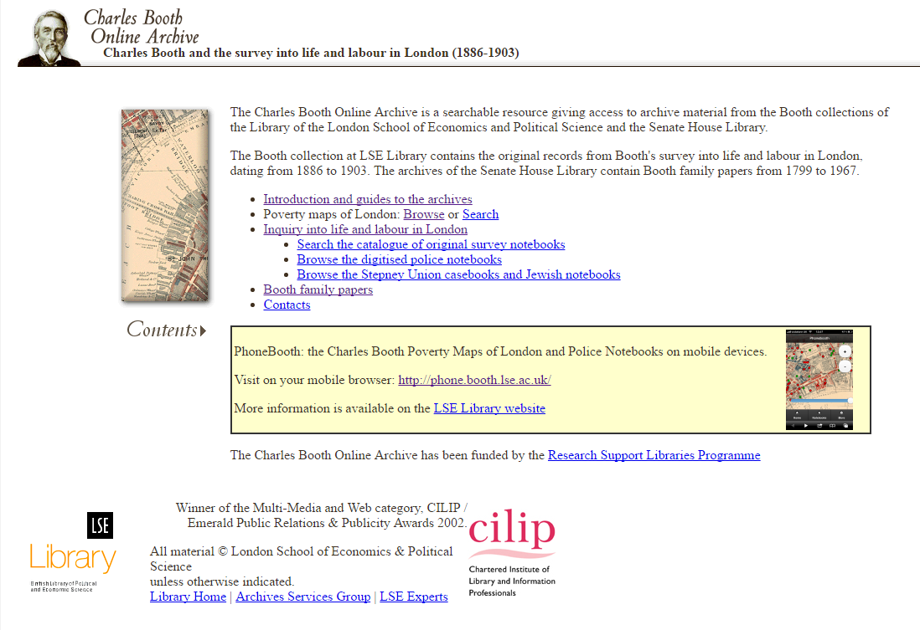
(Very) Old website 1: Charles Booth Online Archive
Notes:
So what did LSE have?
1 very old website- 2002
Did a pretty good job at displaying the archival materials, the maps not so much
Had become challenging to manage

Slide 7
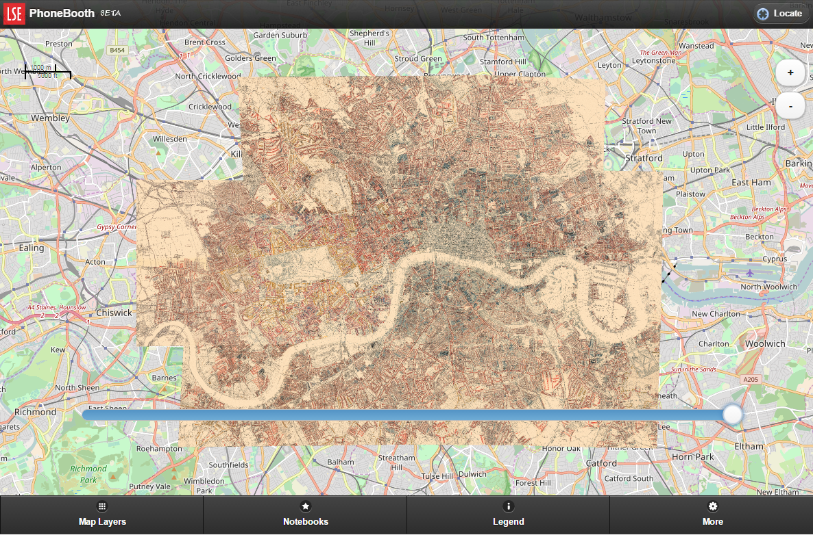
Old(ish) website 2: PhoneBooth
Notes:
1 newer website, from 2012
Experimental, prototypical
Modern mapping functionality, and geolocation of notebooks

Slide 8
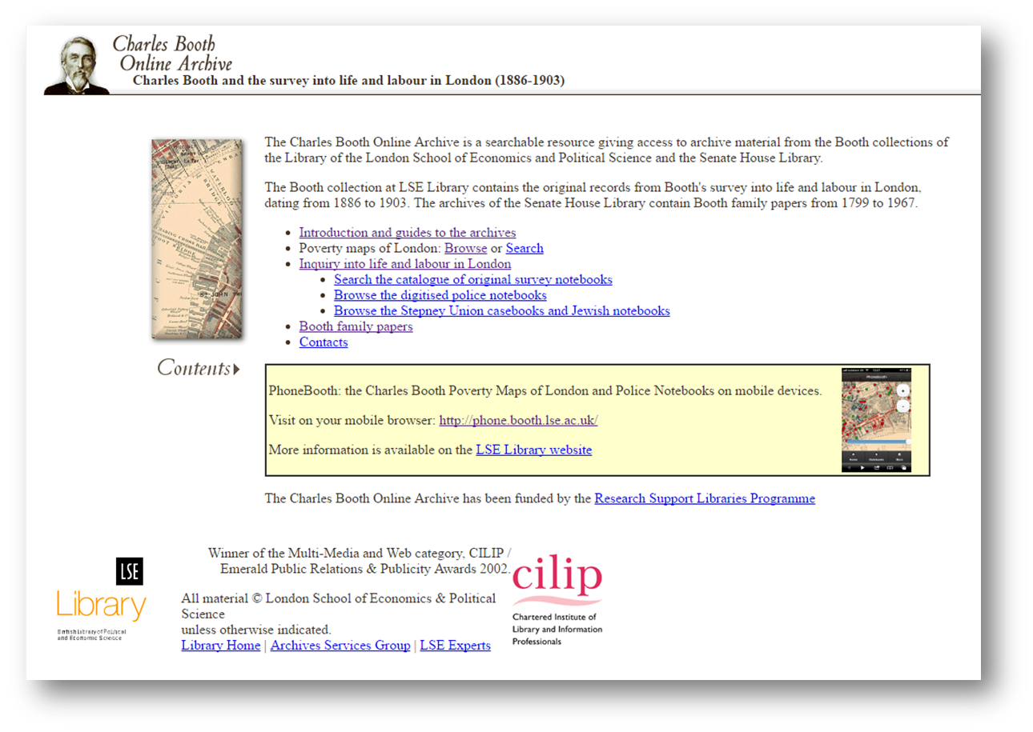
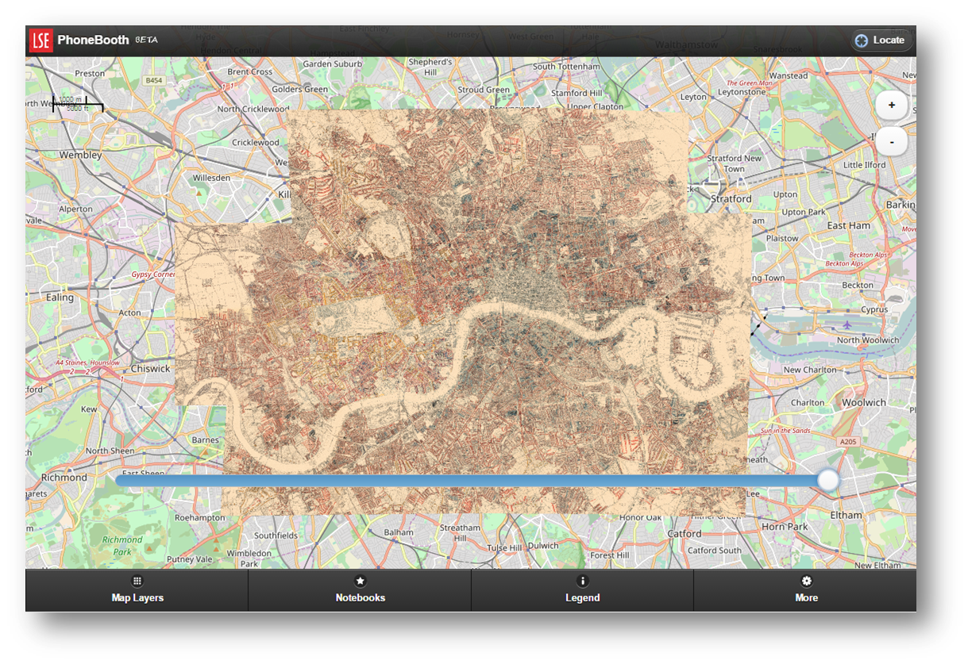
Our project
+
Notes:
We needed to bring the functionality of CBOA together with that of PhoneBooth
But also 100th anniversary of Booth’s death in 2016
LSE Library exhibition
LSE research festival
Booth family memorial event at LSE

Slide 9
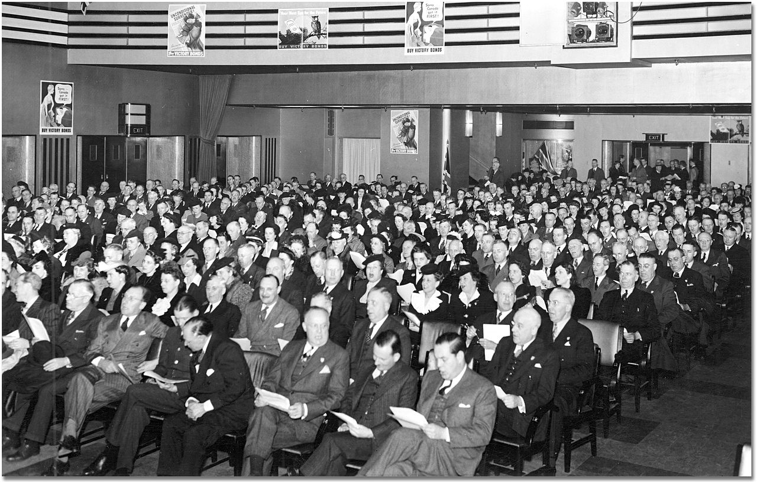
Understanding our audiences
Public domain image from https://commons.wikimedia.org/wiki/File:Eaton's_War_Bonds_Rally_1943_Audience.jpg
Notes:
We surveyed our audience to discover who was using the old sites:
Researchers: historians, criminologists, sociologists etc.
Students & teachers
Family historians & genealogists
The mythical “general reader”

Slide 10
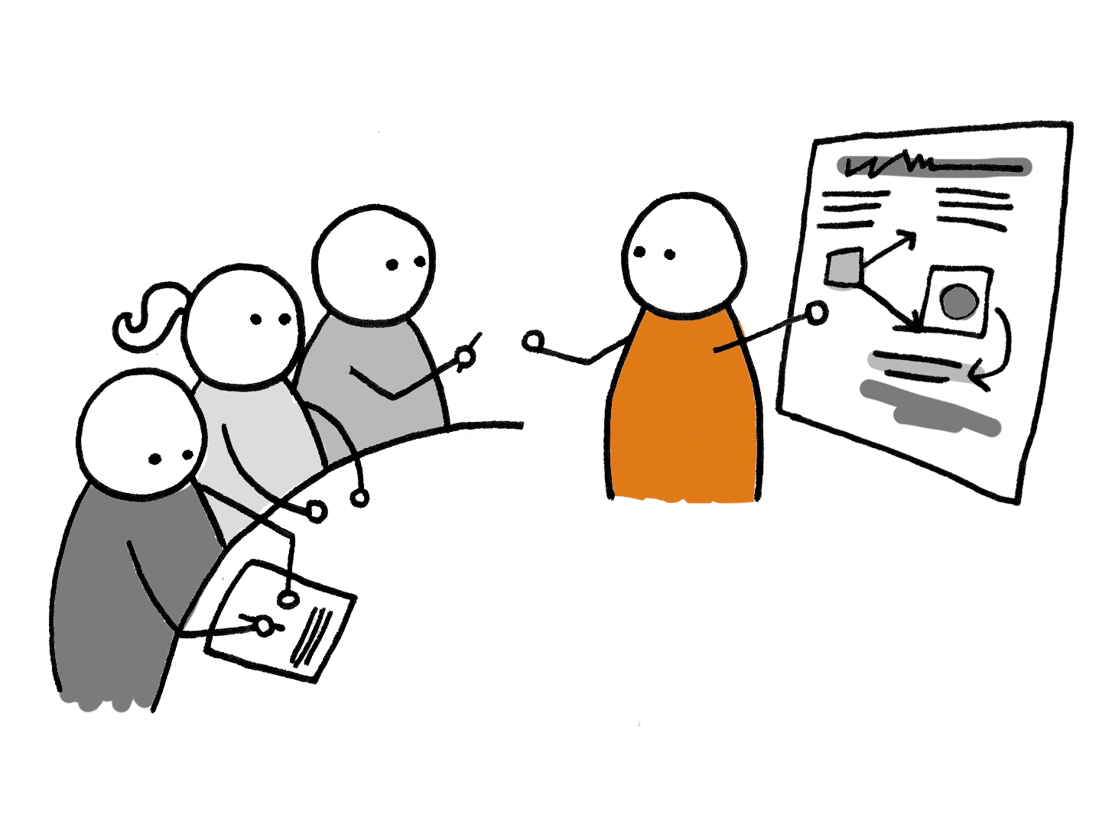
User experience
Andy Bright, User experience design training https://www.flickr.com/photos/flat61/3883611573 CC BY 2.0
Notes:
We tried to pay close attention to our users for what can be a complex archive, particularly given that we wanted to continue to geolocate the Police Notebooks against the Maps.

Slide 11


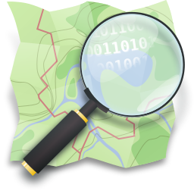
Technical work
Notes:
Tech work was done in-house
IIIF, using the Wellcome’s Universal Viewer: for viewing notebooks
OpenStreetMaps: the modern street layer
Elasticsearch: for search & indexing
Big credit to Digital Library Developer Thom Carter, who developed the technical underpinnings from scratch. Technical write-up to be tweeted after the presentation.

Slide 12
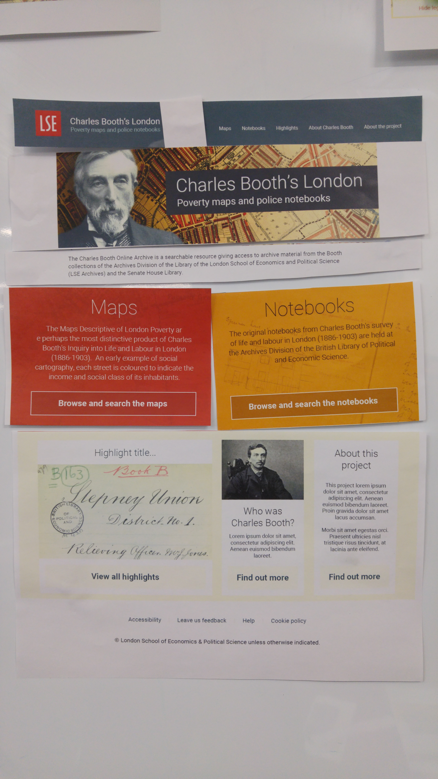
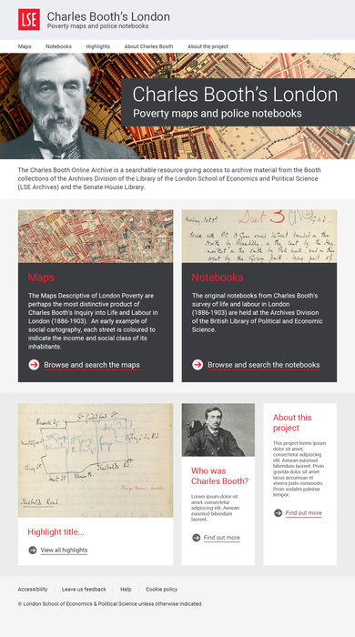
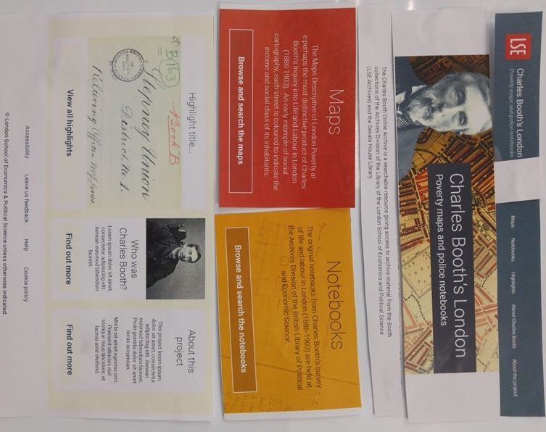
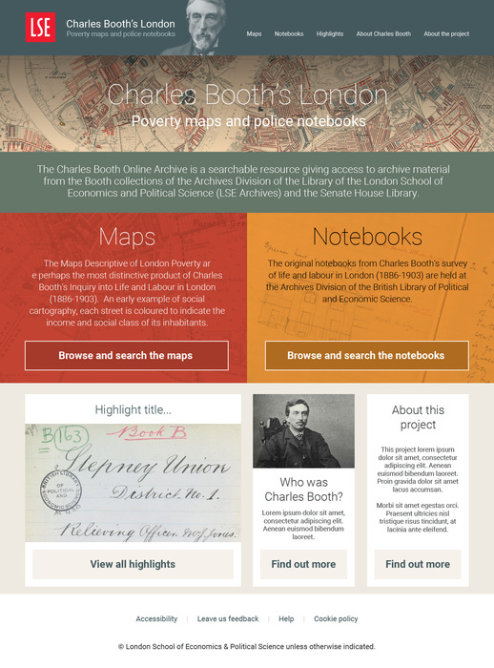
Visual design
Notes:
The screenshots give an idea of the iterative design process
Using the colouration of the maps and LSE “look and feel”
Responsively designed- usable on desktop PC, tablet, mobile phone
Credit here goes to our web design partners Mickey & Mallory

Slide 13
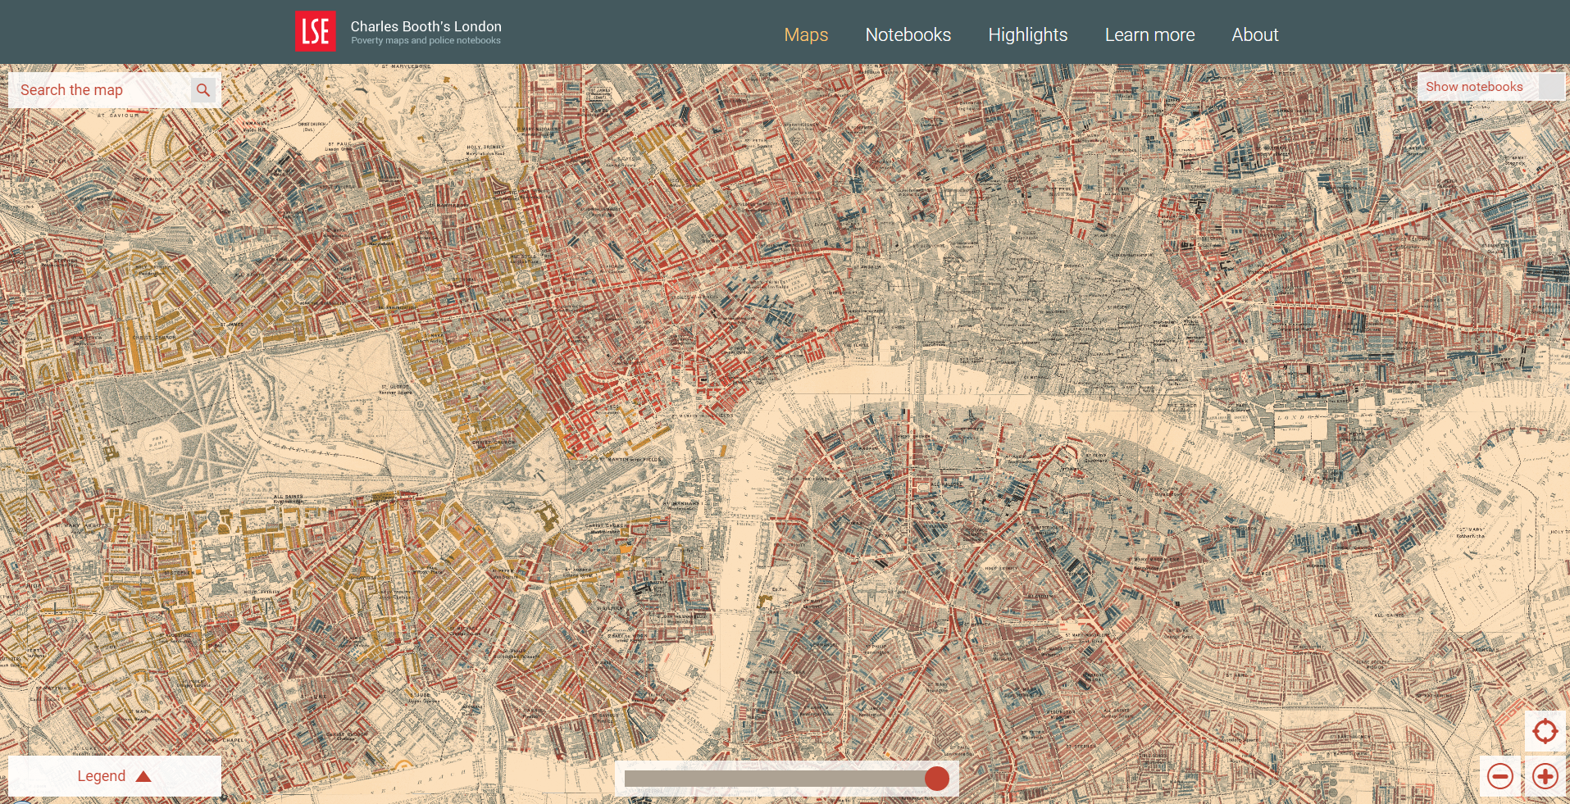
What we came up with: map 1
Notes:
Big, high-resolution version of the 12 maps, stitched together!
Modern map application functionality- drag, zoom etc.

Slide 14
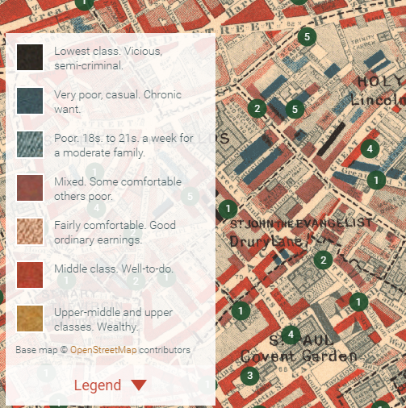
What we came up with: map 2
Notes:
Note the legend, “Lowest class, vicious, semi-criminal”
The dots on the map represent geo-located notebooks, you can click on those and access the notebooks in question

Slide 15
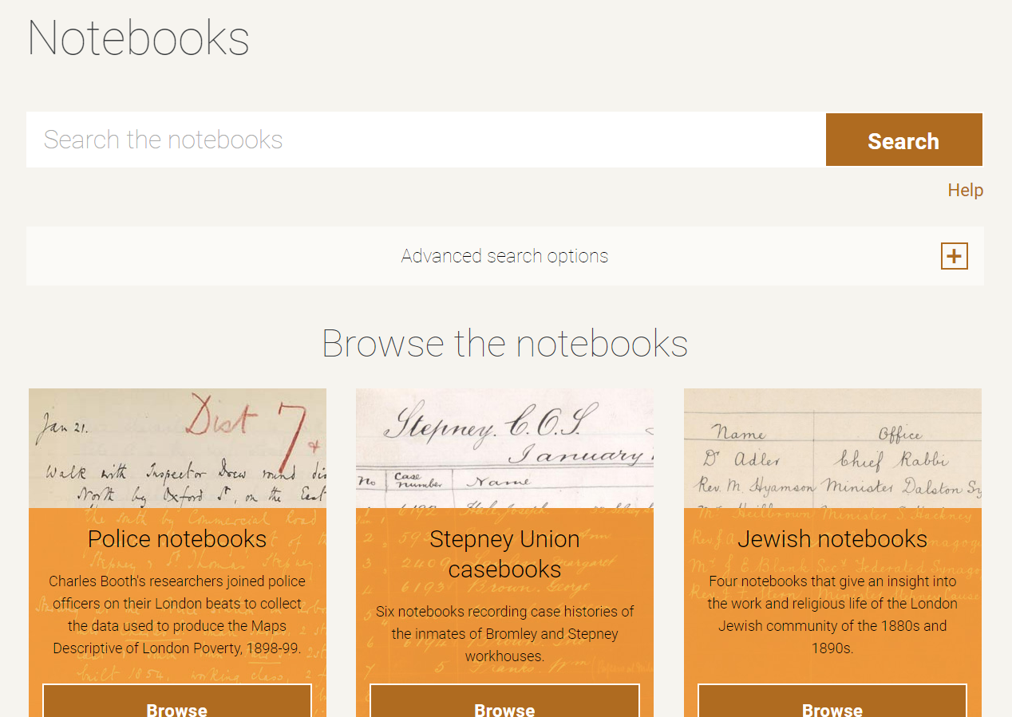
What we came up with: notebooks 1
Notes:
Search and browse functionality, hopefully an intuitive way into the archival material
Note the thematic design continuity from the maps

Slide 16
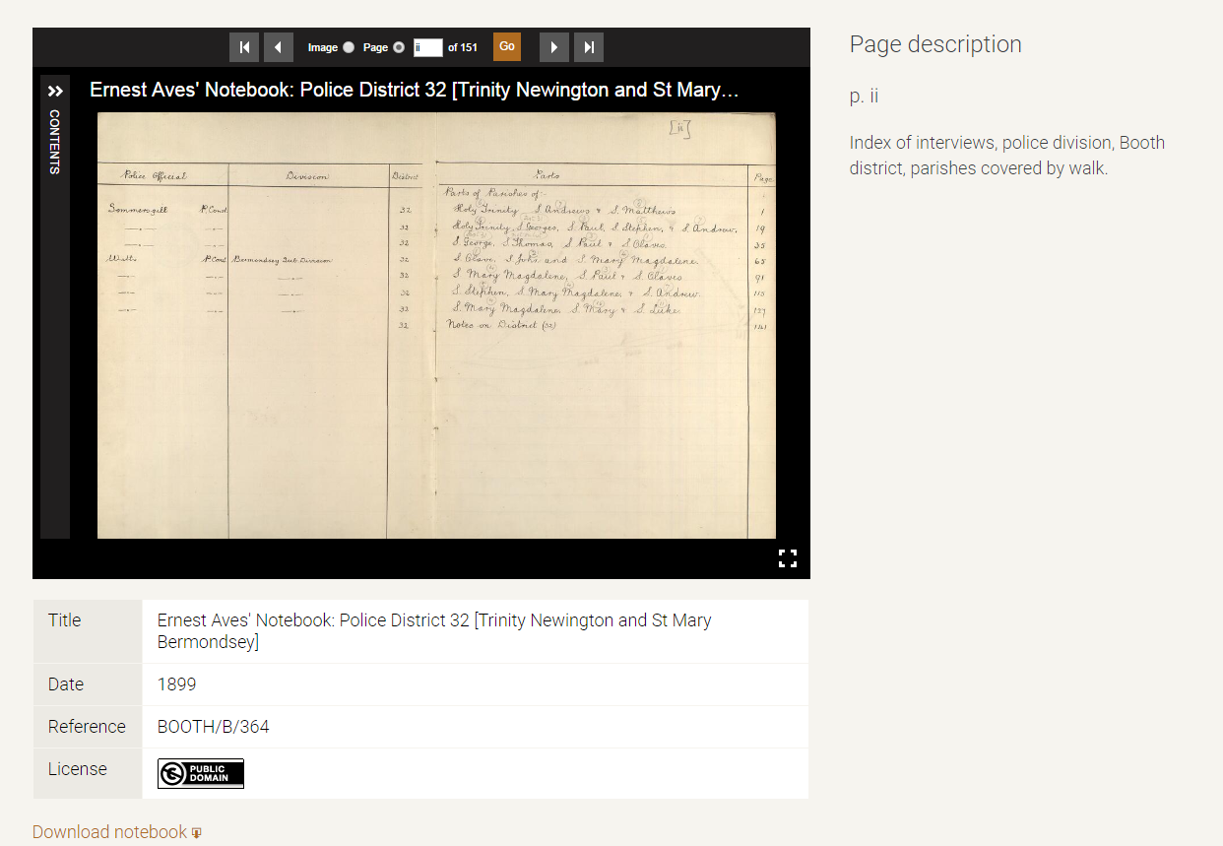
What we came up with: notebooks 2
Notes:
Document viewer, using IIIF Universal Viewer, allowing very deep zoom, easy page turning.
Descriptive metadata to contextualise what is being viewed

Slide 17
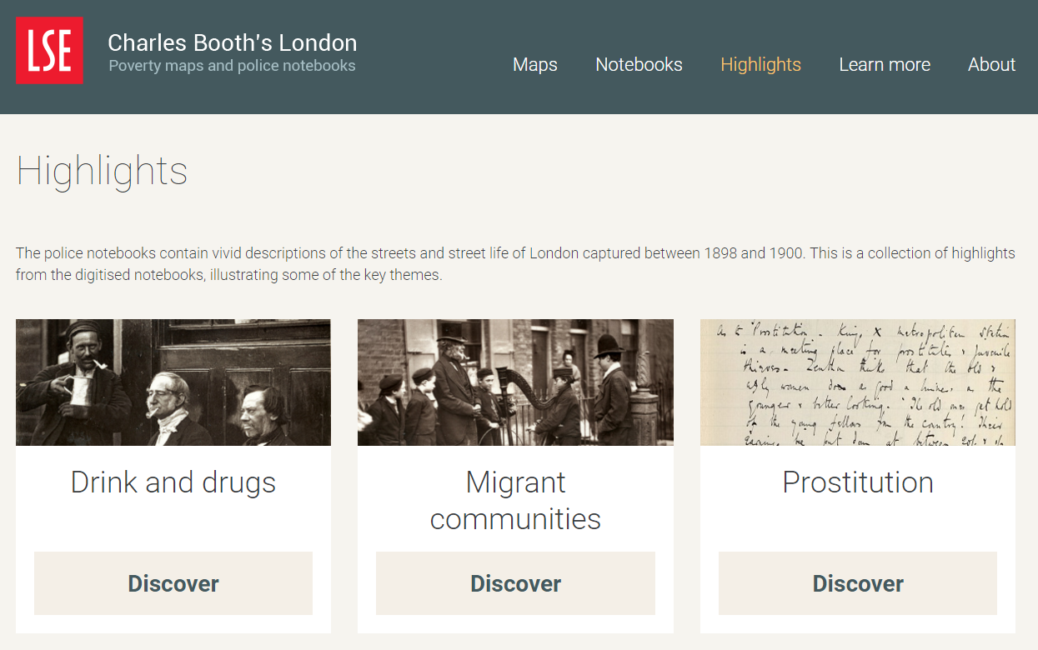
What we came up with: ways in
Notes:
Highlights pages, offering a “way in” to the material
Admittedly a little salacious, but have proven to be very popular!

Slide 18

Reception
Cheers! Happy New Year! https://www.flickr.com/photos/melalouise/341692249 CC BY 2.0
Notes:
Successful publicity drive
Lots of hits on the site- at launch we saw some 2,105 sessions in a single day
picked up by LSE channels, Londonist, Smithsonian Magazine
Encouraged us to do further work!

Slide 19
The future
(More) User experience testing
Digitisation of the rest of the archive
More highlights articles
Gazetteer of Victorian London
Notes:
It’s the last one I want to highlight here:
We don’t currently have the ability to search the map of Victorian London- this is a problem, some 50% of streets have disappeared, changed name
We’re working on this at the moment, using data kindly supplied by the GB1900 project

Slide 20
Thank you!
https://booth.lse.ac.uk/
n.stewart@lse.ac.uk
@neilstewart
IIIF logo: By International Image Interoperability Framework - Github page for the project, https://github.com/iiif image url: https://avatars3.githubusercontent.com/u/5812589?v=3&s=200, Public Domain, https://commons.wikimedia.org/w/index.php?curid=38701676
OpenStreetMap logo: By Ken Vermette - https://wiki.openstreetmap.org/wiki/File:Public-images-osm_logo.svg, CC BY-SA 2.0, https://commons.wikimedia.org/w/index.php?curid=4075670
Elasticsearch logo: © elastic, https://www.elastic.co/products/elasticsearch

