Slide 1
Charles Booth's London: bringing together maps and archives on the web
Neil Stewart, Digital Library Manager, LSE Library

Slide 2
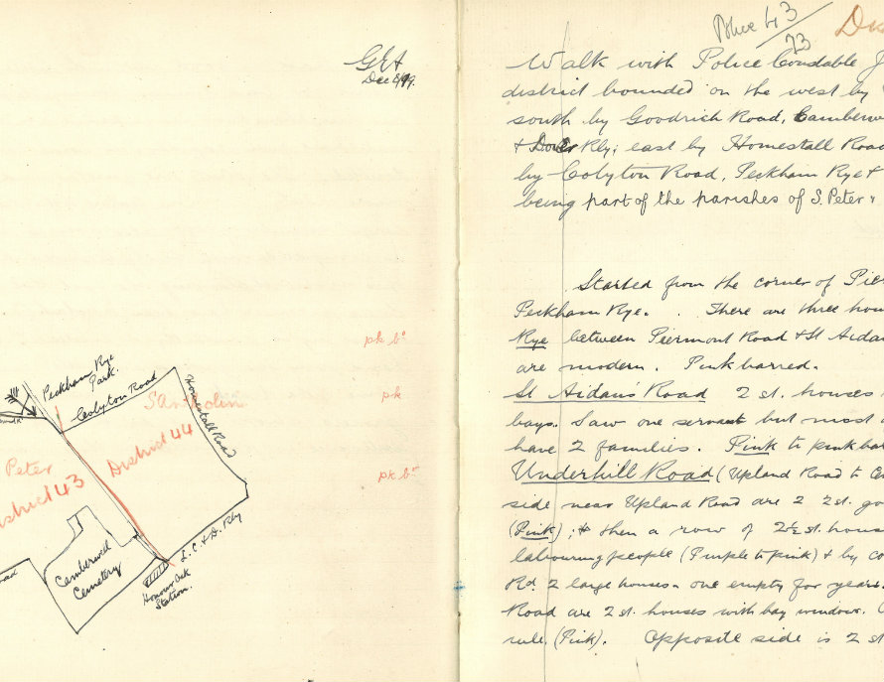
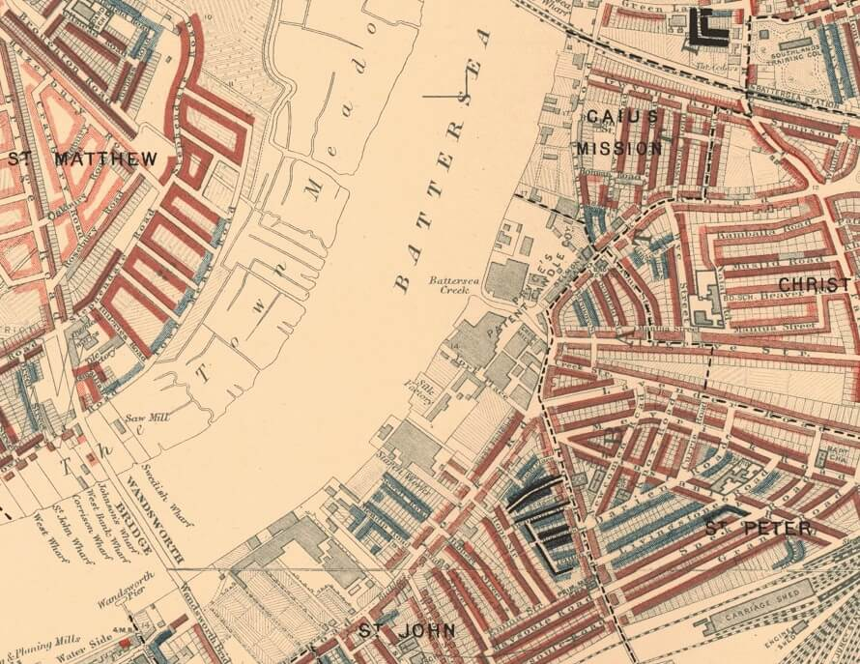
Who & what?
Notes:
Who here has some knowledge of Booth, his project, the poverty maps?
Charles Booth: Victorian businessman, philanthropist & social reformer
Booth’s project: to understand the extent of poverty in Victorian London
Mammoth research project, involving a large team, lasted over 15 years
Landmark piece of social science research
Handed down to us, by way of excellent Victorian research data management, as the following:
Life and Labour of the People in London (4 editions, 1889 – 1903). Final edition 17 volumes, over 4,000 pages.
Poverty maps (12 individual maps)
Notebooks, inc. the Police Notebooks. C. 450 books.
Full archive held at LSE Library, considered to be a “jewel in the crown” for LSE

Slide 3
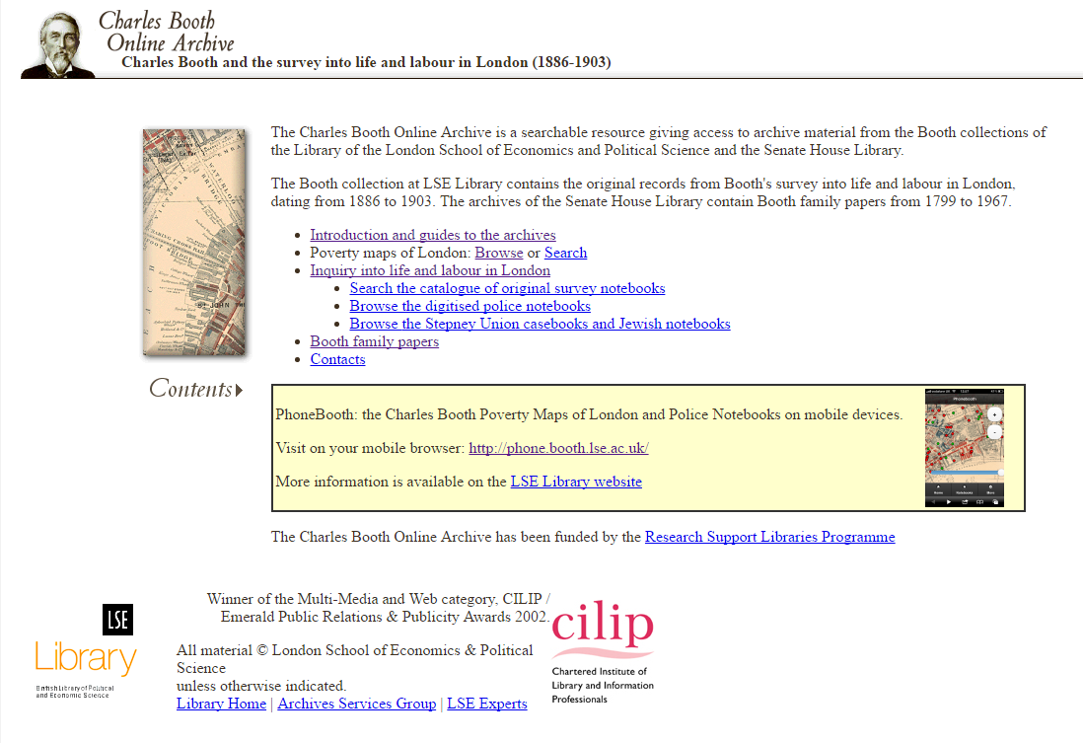
(Very) Old website 1: Charles Booth Online Archive
Notes:
“Winner of the Multi-media and Web category, CILIP/Emerald Public Relations & Publicity Awards 2002”
Did a pretty good job at displaying the archival materials, the maps not so much
Became challenging to manage

Slide 4
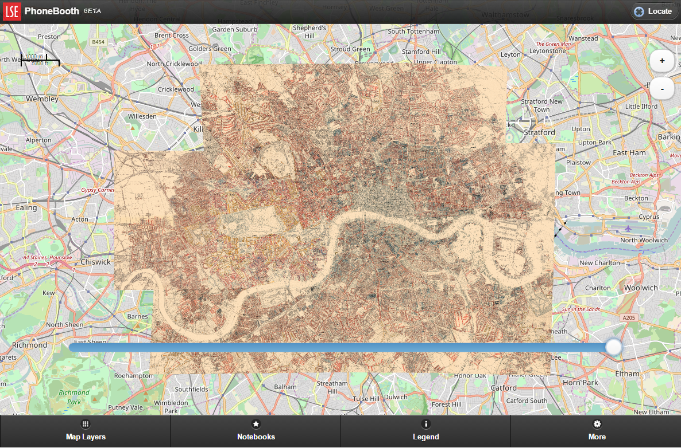
Old(ish) website 2: PhoneBooth
Notes:
Experimental, prototypical
Credit to EDINA for helping us with geo-location, and to Jisc for funding it as a project

Slide 5
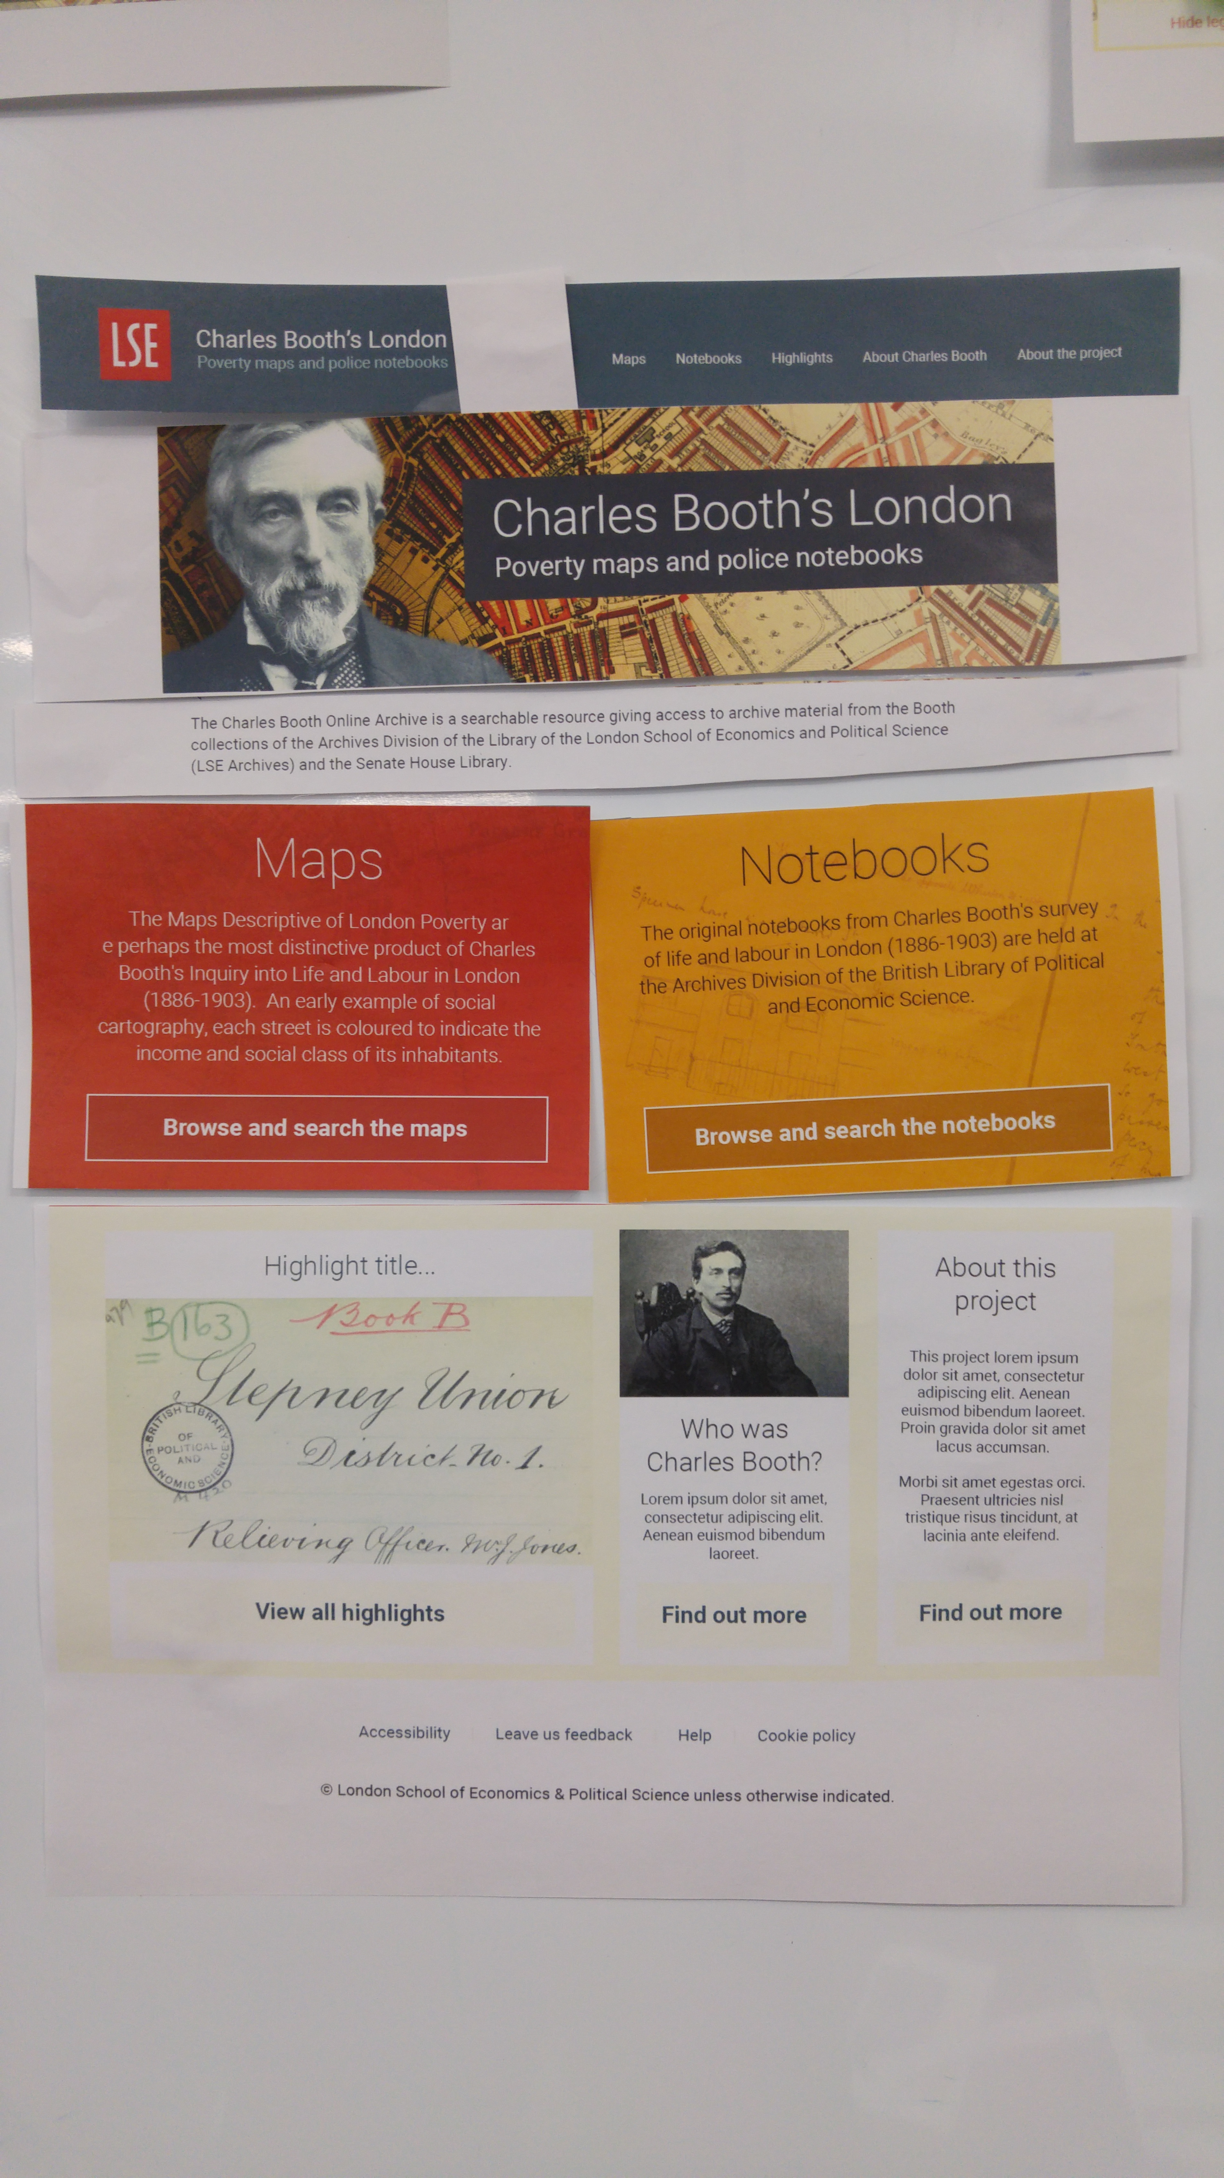
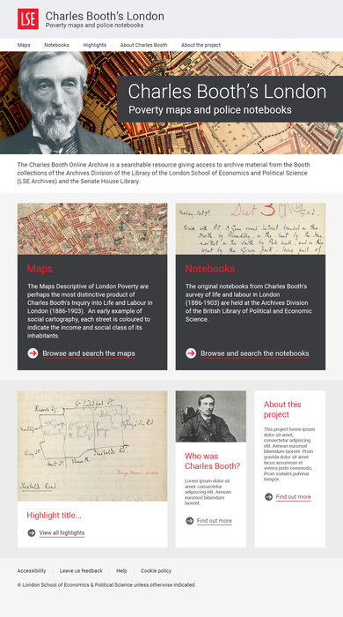
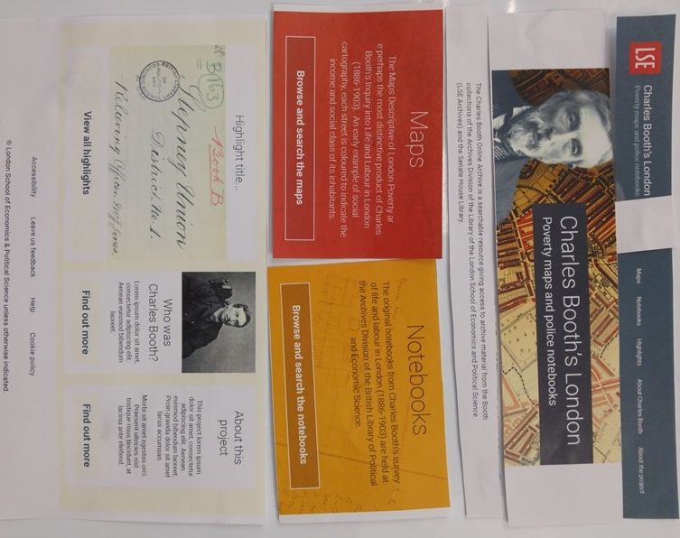
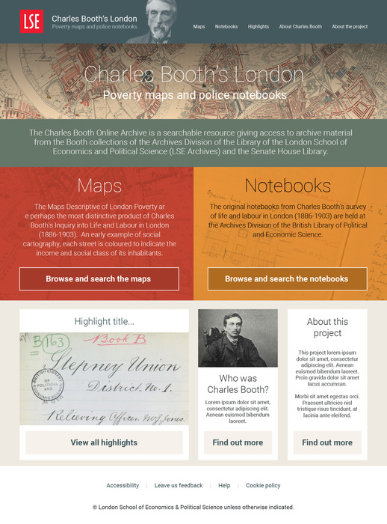
What we did
Notes:
Needed to sort out & bring together functionality of old websites
But also 100th anniversary of Booth’s death: exhibition, research festival, Booth family memorial event
A cross-Library team
Division between out-sourced web design and in-house technical development
Our web development partners Mickey & Mallory
UX & audience analysis, followed by web & technical development
Significant data-wrangling element of GIS data, from both CBOA and PhoneBooth.
Project started in May 2016, completed end of November 2016
The screenshots give an idea of the iterative design process

Slide 6
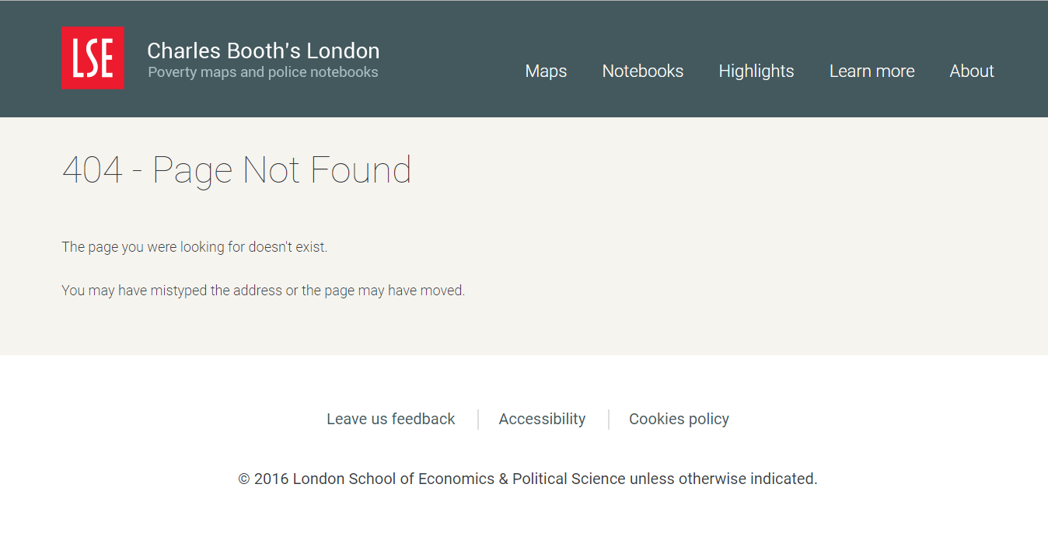
Live demo!
Notes:
Home page – UX research. Colour scheme based on maps. Primary architecture.
Maps:
Legend
Opacity slider
Map search: “southwold road”, “st matthew”, using OS data
Notebooks & maps relationship:
Notebook overlay: ability to access notebooks from the Maps
And also access the maps via the Notebooks [notebook search for “High Holborn”]
Demonstrate full-screen, zoomed notebook including diagrams
Highlights pages
Challenges
Interaction design: Non-digitised notebooks- how to signal this?
Discrepancies between Victorian and modern-day London: how to address these?

Slide 7
Some notes on technology
OpenStreetMap, OS Names API
IIIF & Universal Viewer
Elasticsearch
Full technical write-up by Developer Thom Carter: https://medium.com/@tjvc/re-building-charles-booths-london-f042ed23a32a#.in29bb1lg

Slide 8
The future
User experience testing
Gazetteer of Victorian London
Digitisation of the rest of the archive
More highlights articles

Slide 9
Thank you!
https://booth.lse.ac.uk/
n.stewart@lse.ac.uk
@neilstewart
Image credits: all from LSE’s Booth websites, © LSE

