Slide 1
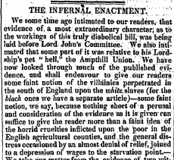
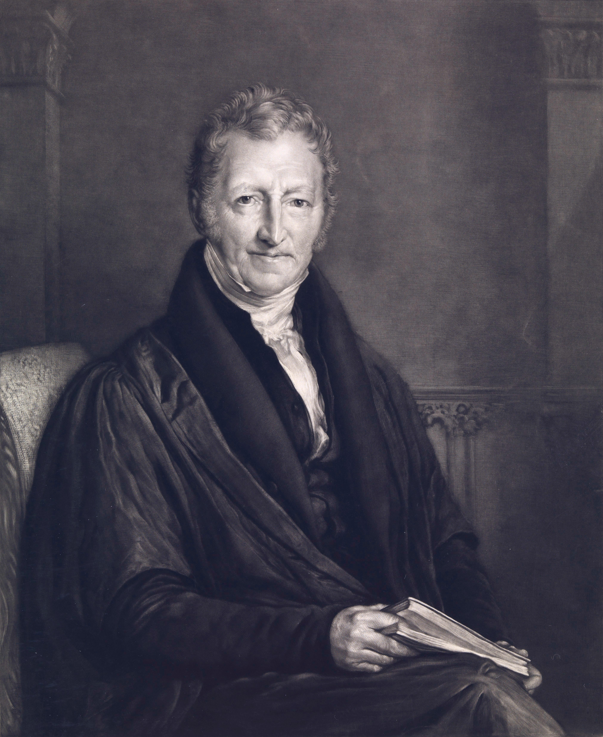

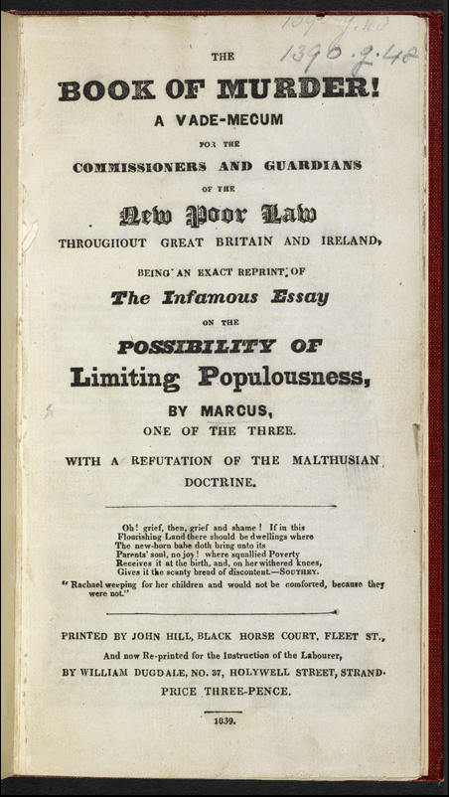
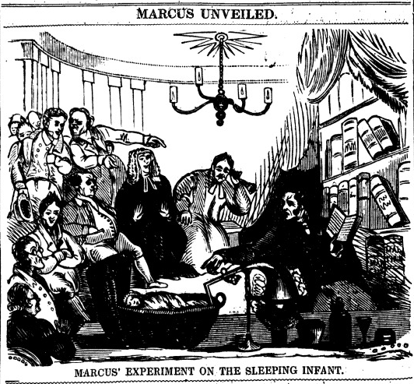
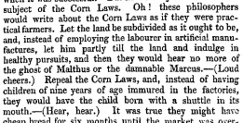
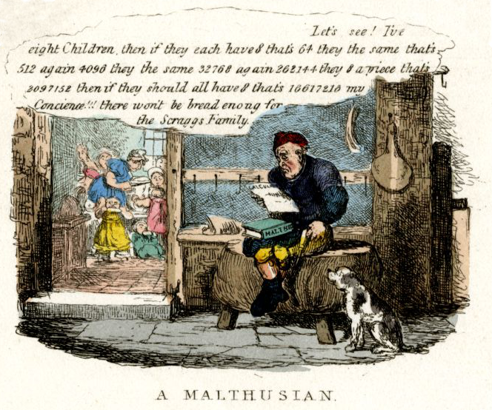
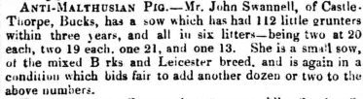
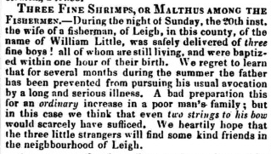
The Ghost of Malthus
Malthus and Malthusianism in 19th century public discourse; a bibliometric approach to the history of economics
Maxine Montaigne, PhD Candidate
Economic History, LSE
T. R. Malthus (1766-1834) is arguably one of the most recognisable names in the history of economic thought; the quintessential dismal scientist and a household name to this day. But his famous theory of population, while controversial, was not particularly original, nor well received by other economic thinkers of the time. What explains the persistence of Malthus in public consciousness for more than two centuries? Looking at the role that Malthus’ ideas played in popular discourse will allow us to answer this question, as well as the wider question of why some economic ideas are so successful.
Figure 1: References to Malthus in British books, source: Google Ngram
To understand the changing place of Malthus in popular discourse I look at a range of different media in which the debates on population and poverty were waged; books, periodical reviews and finally newspapers. Google’s ‘Ngram’ project represents the digitisation of over 8 million books, allowing us to see the frequency with which certain words appear over time (Figure 1). We can see that Malthus, though very popular in the early 19th century, drops out of public debate almost immediately after his death in 1834, with interest surging again at the end of the century. This pattern is repeated in the major periodicals of the 19th century (Figure 2), in which we see a sharp drop in references to Malthus in the middle of the century and then a later revival.
Figure 2: References to Malthus in periodical Reviews, source: ProQuest
However when we look at the references to Malthus in the newspapers of the day (Figure 3) a different picture emerges. Instead of interest in Malthus dropping off after his death in 1834, references in the newspaper actually peak in the 1830s and 40s. This suggests that within the more popular level of public discourse, far from losing relevance, Malthus became an important part of the debates raging in this period, notably surrounding the controversial Poor Laws. Interestingly, the periods in which total references to Malthus are highest also correspond to the periods in which the relative importance of the terms ‘Malthusian’ and ‘Malthusianism’ is highest.
Figure 3: References to Malthus, 'Malthusian' and ‘Malthusianism’ in 19th century British newspapers, source: Gale Cengage/British Library
Figure 4: A selection of clips from British newspapers
This analysis therefore suggests that popular discourse played an important role in the dissemination and persistence of Malthusian ideas. Newspapers, available cheaply and widely, allowed for the continued public awareness of Malthus and his theories, even when his relevance in the ‘higher’ level debate of books and periodicals was greatly diminished. It is through this use of novel bibliometric techniques that we can shed light on the changing nature of public discourse in a way that traditional reading of texts cannot achieve.
Figure 5: ‘A Malthusian’, detail from Robert Seymour (1829) The March of Intellect, source: British Library
For more information please contact
Maxine Montaigne: m.c.montaigne@lse.ac.uk
References:
Agriculture. (1838, September 22). The Lancaster Gazette and General Advertiser, for Lancashire, Westmorland, &c.
Chelmsford. Rayleigh. (1839, October 25). The Essex Standard, and General Advertiser for the Eastern Counties. Colchester, England.
Marcus [pseudonym]. (1839). The Book of murder! London: John Hill, Black Horse Court, Fleet St.,
and now re-printed for the instruction of the Labourer, by William Dugdale, No. 37, Holywell Street, Strand.
Marcus Unveiled. (1839, March 2). The Northern Liberator. Newcastle-upon-Tyne, England.
The Delegates in London. (1839, February 17). The Charter. London, England.

