Slide 1


LSE’s Adventures in Wikidata-land:
Tears and Triumphs down the Rabbit Hole
Helen Williams
Metadata Manager
@HelsKRW
Library

Slide 2



Creates bridges across domains
Impacts search engine results
Content in Linked Open Data Ecosystem
Identifier hub
Structured database
Reusable data
Multilingual
Open Knowledgebase
Free

Slide 3

Digital shift
Global
Growth in experimental projects
Establishing partnerships
Local
CDG DSIG
Development & exploration of new ways in which metadata can support research, teaching and learning
Review & reprioritise
Release time
TAKE RISKS!!!

Slide 4

Cultivating relationships
Collaborative partnership with Research Support Team
Wikimedia Community
Reaching out to UK experts
Interested colleagues acting as sounding board
SHAPE
https://www.wikidata.org/wiki/Q103462225
https://en.wikipedia.org/wiki/Social_Sciences,_Humanities_and_the_Arts_for_People_and_the_Economy
LSE Communications Division

Slide 5

Training
1. Exporting data from LSETO and preparing it for import to OpenRefine
2. Importing data to OpenRefine
3. Data reconciliation in OpenRefine
4. Preparing for and importing to Wikidata
5. Automating addition of Ethos ids
6. Automating addition of ProQuest ids
7. Automating addition of DART Europe ids
8. Automating addition of CORE ids
9. Round tripping data
Data Shapers Community of Practice
OpenRefine
Starting at the end!

Slide 6




Challenges
No cameras
Remote troubleshooting
Slow internet
Lack of expertise

Slide 7
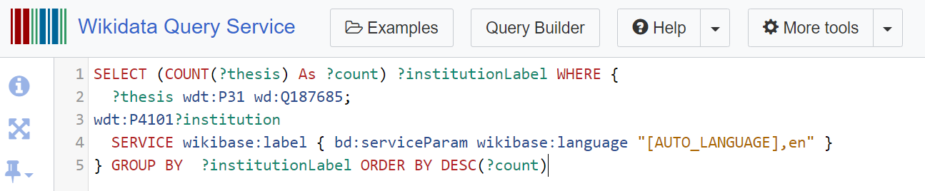
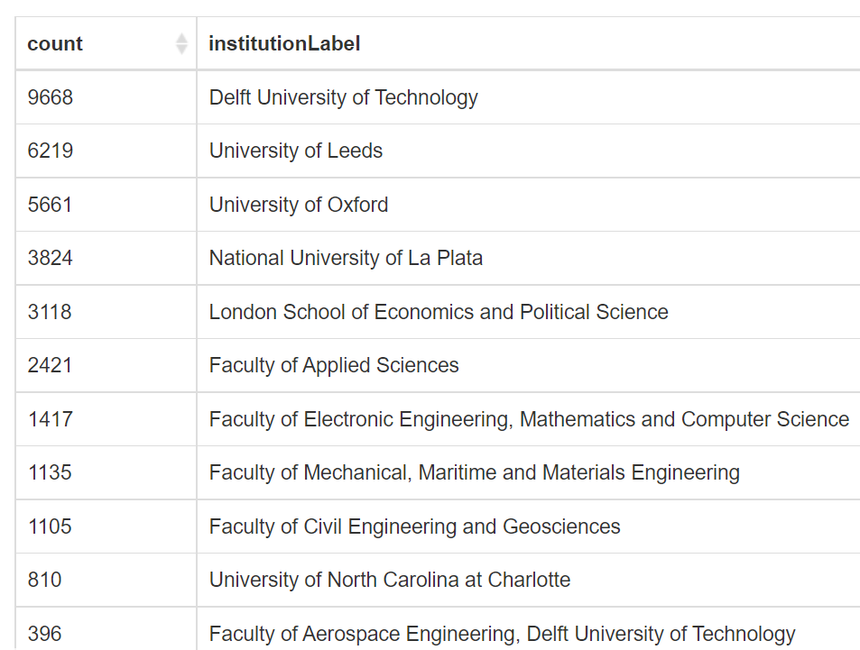

Interim analysis of reach and engagement
I Institutional theses ranking in Wikidata
https://w.wiki/jwZ

Slide 8


Interim analysis of reach and engagement
Downloads
Total downloads Feb-May 2021 14% higher than same time period in 2020 (For comparison previous 3 years saw increase of 6.9% and decreases of 5 and 12% respectively)
Analysis of 80 titles added to Wikidata - Downloads in the 6 months after adding titles to Wikidata on average 47% higher than the 6 months before addition to Wikidata

Slide 9


Interim analysis of reach and engagement
Google Analytics for LSETO
Primary referral source Google Scholar – approx. 40% of traffic
Second referral source Twitter – approx. 10% of traffic
10 sources referring 1-6% of traffic each
Long tail of 300 sources referring 0.x or 0.0x% of traffic each
6 months preceding Wikidata work - average 3.82% traffic from Wikipedia
6 months after Wikidata work - average 9.31% traffic from Wikipedia
With most recent week of analysis 13.61%
Etheses.lse.ac.uk on Twitter
38 mentions Feb-May 2020, increasing to 74 for same time period in 2021

Slide 10

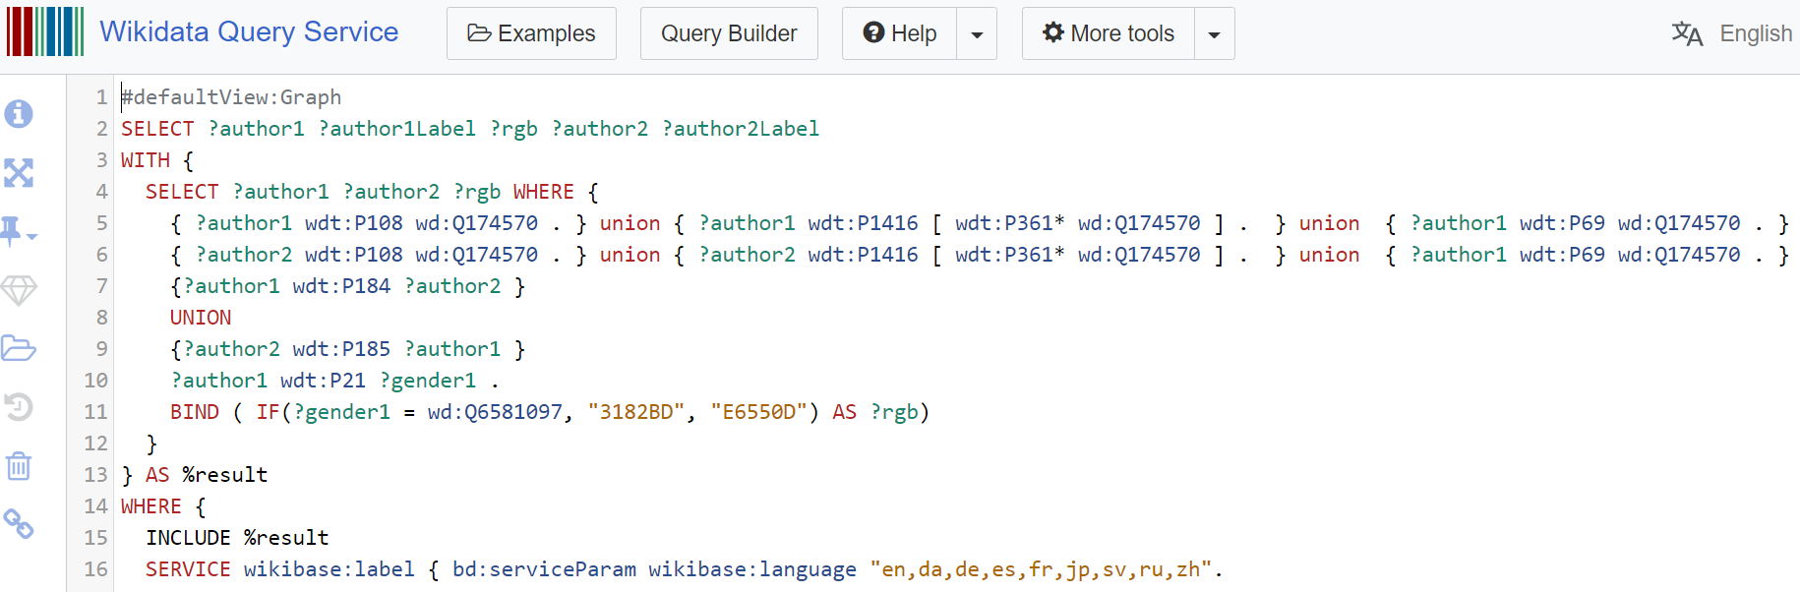
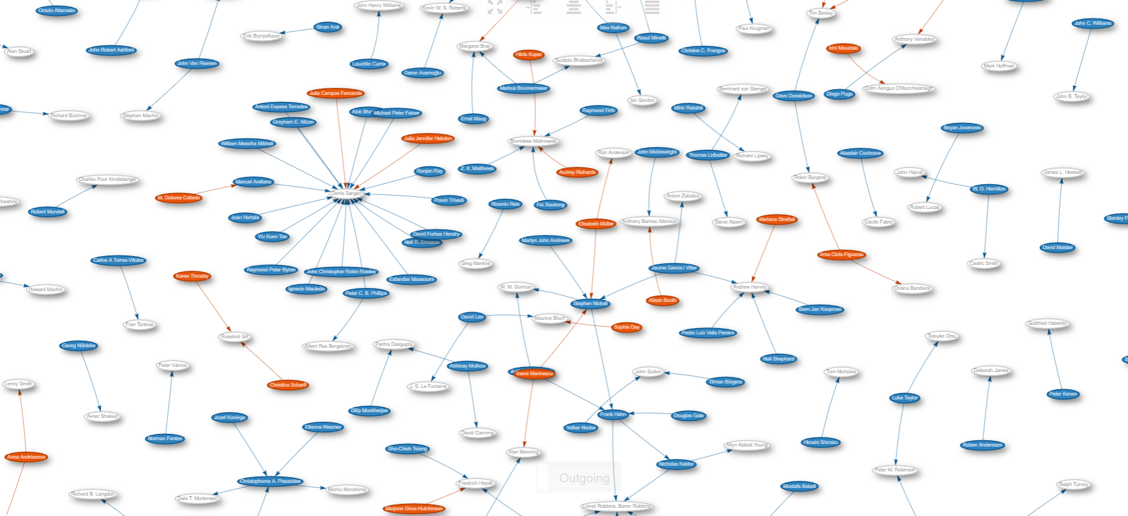
Visualisation
https://w.wiki/3Z$7

Slide 11


Where next?
Extend reach of content & data unique to LSE
Develop digital scholarship expertise
Open Access focus
Special collections focus
Digitised content focus
Researcher focus

Slide 12



In conclusion
Tears & Triumphs
And more to explore about the role of metadata in supporting research, teaching and learning.

Slide 13
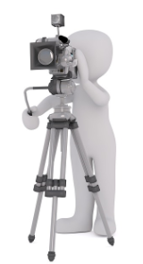
Photo credits
Slide 1: CC0, Pixabay.com
Slides 2-13: CC0, 3dman-eu: Pixabay
Slide 2, 7, 10: CC0, https://www.wikidata.org

