Slide 1
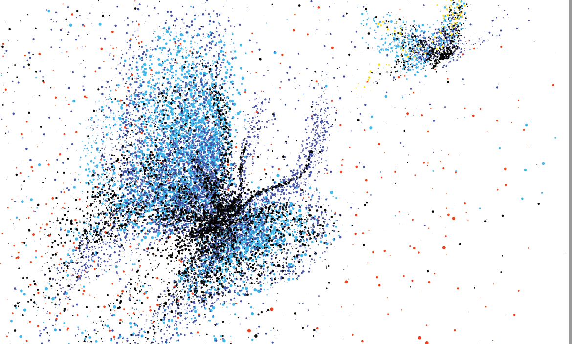

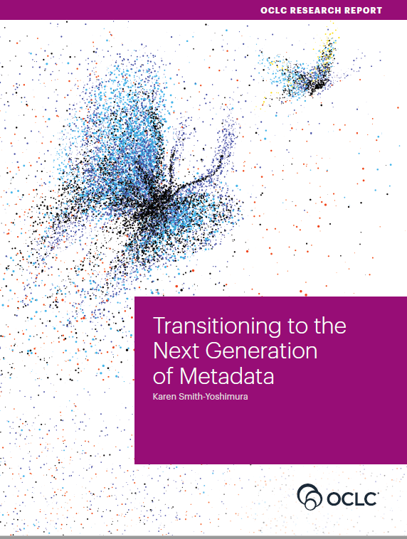
RLP Works in Progress 12 January 2021​
Transitioning to the Next Generation of Metadata
Key trends in context
Notes:
Good morning, everyone!
First of all I would like to thank you for this opportunity to present at this library congress.
My co-presenter and I are both delighted to be with you today, at least virtually.
In our presentation, we would like to share with you some key trends that shape the current transition to what we call the next generation of metadata, and then also provide lots of concrete examples for each of those from a very specific national context, to illustrate those trends.

Slide 2


Speakers
Annette Dortmund
Senior Product Manager &
Research Consultant, OCLC
Helen K. R. Williams
Metadata Manager, LSE Library
Notes:
My name is … I am … A historian by training, I have worked on topics related to next-gen metadata for a couple of years now, mostly in the area of persistent identifiers.
And my co-presenter, Helen …

Slide 3

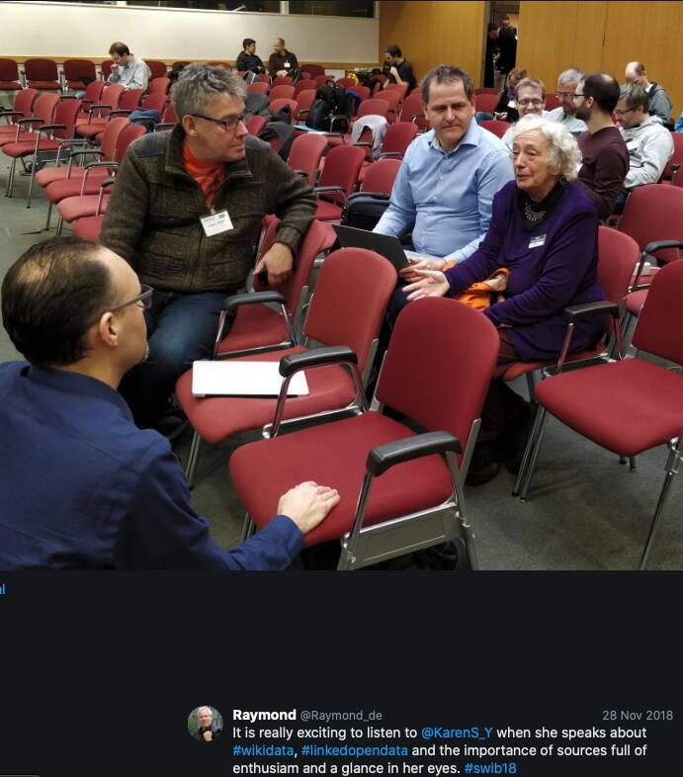

Karen
Smith-Yoshimura
OCLC Research Senior Program Officer (retired Nov 30, 2020)
Notes:
With this presentation, I am standing on the shoulders of a giant in metadata land – my former colleague at OCLC, Karen Smith-Yoshimura, who just recently retired.
For 25 years, Karen has worked extensively on the metadata needed to describe and provide access to the multilingual rEsources managed by libraries, archives and museums and other cultural heritage organizations. Her work also included identifiers and linked data.
As an OCLC Research Senior Program Officer, Karen has also for many years convened discussions among Metadata Managers within the OCLC Research Library Partnership, the so-called OCLC Research Library Partners Metadata Managers Focus Group (quite a mouthful), a transnational group of subject matter experts from 11 countries spanning four continents.
The rich, robust and sustained discussions of this diverse group over many years formed the fundament for her final report and opus magnum, “Transitioning to the Next Generation of Metadata”, which is a meta-synthesis of the key trends that emerged from the discussions, shines a light on the evolution of the next generation of metadata and offers clear direction for libraries.

Slide 4
The Transition to Linked Data and Identifiers
Describing “Inside-Out” and “Facilitated” Collections
Evolution of “Metadata as a Service”
Preparing for Future Staffing Requirements
Smith-Yoshimura, Karen. 2020. Transitioning to the Next Generation of Metadata. Dublin, OH: OCLC Research.
https://doi.org/10.25333/rqgd-b343
Notes:
Karen’s report, of which my co-presenter as well as myself were reviewers, categorized the content in these four sections, which we are going to use to structure today’s presentation.
I will briefly highlight some key takeaways from each of these sections, and Helen will provide rich context and examples for each.

Slide 5
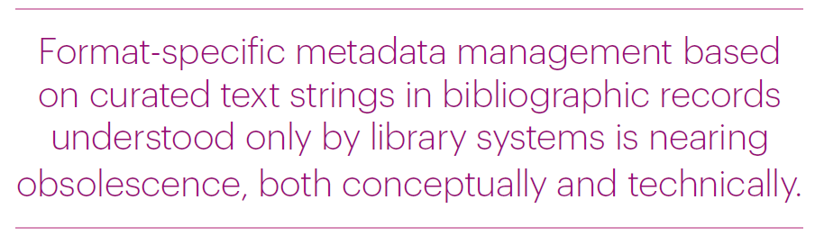
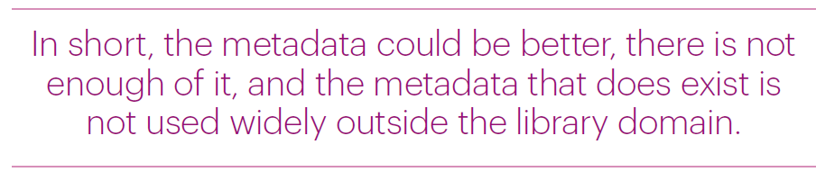
Context
Notes:
Let us first look at the context for this transition to next-generation metadata.
What is the problem, and what are the main drivers here?
Quite simply, there is frustration given the state of current metadata.
READ
To put it differently, “traditional methods of metadata generation, management and dissemination are not scalable or appropriate to an era of rapid digital change, rising audience expectations and diminishing resources.” as the British Library observes in their Collection Management Strategy 2019-2023 document.
(https://www.bl.uk/bibliographic/pdfs/british-library-collection-metadata-strategy-2019-2023.pdf)
CLICK - READ
Something clearly needs to change.
Helen, would you like to share your perspective?

Slide 6

Context
Metadata for collections and research outputs
For local communities &
the wider world
Contributing to the global web of data
Notes:
Many of the trends in Karen’s OCLC report were raised at the UK’s Future of Cataloguing events held during 2019.
In drawing out the UK context I’ll cover metadata for collections and research outputs in support of our local communities and the wider world, with a focus on how our metadata transition can contribute to the global web of data.
This will be a whistle-stop tour so there will undoubtedly be some things I don’t cover and some inevitable bias to work at my own institution. You will also be aware of work in your own areas and I’d encourage you to share that with each other. We are stronger as professionals when we collaborate and support and learn from one another. Links to everything I mention are at the end of the slides.

Slide 7
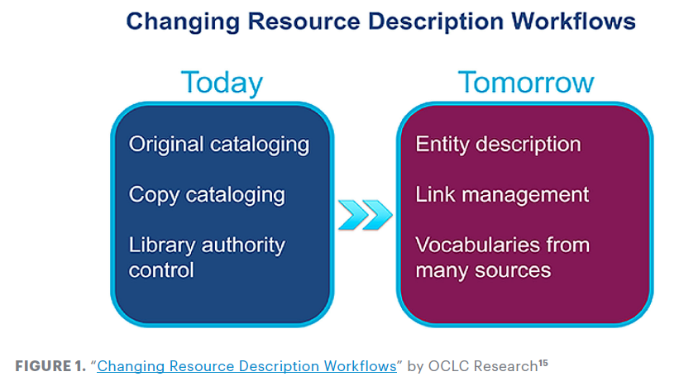
Transition to Linked Data & Identifiers
Transition to Linked Data & Identifiers
“Persistent identifiers were viewed as crucial to transitioning from current metadata to future applications.”
Notes:
A large part of the report depicts the changes taking place in the transition to linked data and identifiers, in particular the changing resource description workflows.
Moving from READ to READ (per line)
In all the discussions over the years, Metadata Managers viewed persistent identifiers as crucial …
READ

Slide 8
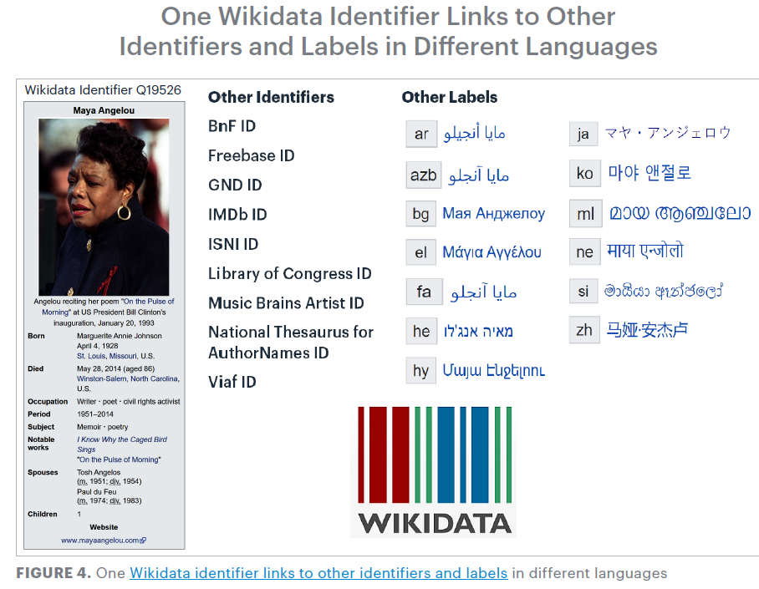
Transition to Linked Data & Identifiers
“Identity management poses a change in focus…to describing entities …and the relationships among them.”
Notes:
One of the shifts underway is from authority control to identity management, and the value of “identifier hubs” such as Wikidata to aggregate identifiers pointing to the same entity and also offering labels in different languages and writing systems.
So in this example from the American poet Maya Angelou you see just a sample of the 60+ identifiers and name labels that the Wikidata has aggregated together, including those from the library domain.
If compared to authority control, identity management … READ

Slide 9
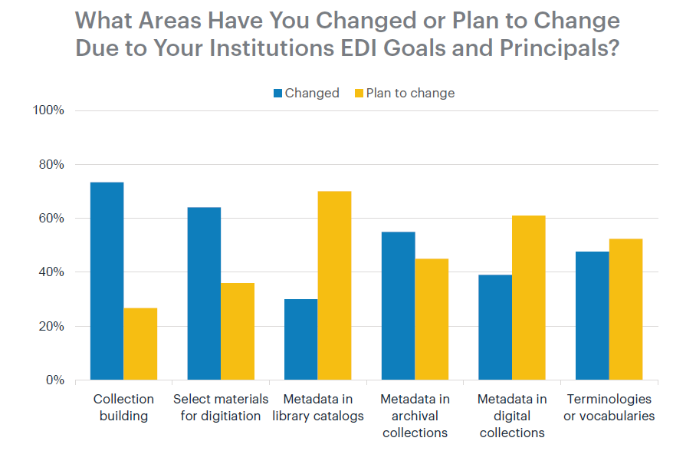
Transition to Linked Data & Identifiers
“Addressing language issues is important as libraries seek to develop relationships and build trust with marginalized communities.”
Notes:
Why is this relevant?
To give one example:
In 2017, OCLC Research conducted a survey on the topic of Equity, Diversity and Inclusion (EDI) and asked institutions in the Research Library Partnership “What areas have you changed or do you plan to change due to your institution’s EDI goals and principles?”
In comparison to all the changes institutions had already made in their workflows to comply with their EDI goals and principles, metadata in library catalogs (third from left on the graph) lagged behind. Institutions were planning changes, but about a third only had already implemented changes.
The ability to link to multiple vocabularies with different labels as indicated in the previous slide is a promising approach to address language issues, and READ
So, the transition to linked data and identifiers is really key to achieving important library goals.

Slide 10

Publisher metadata
BL working with 5 publishers to seed their metadata with ISNIs
BIC Metadata Capabilities Directory
Transition to Linked Data & Identifiers
Notes:
In terms of the transition to Linked Data, on the whole UK librarians have had less opportunities to be involved in the bigger kind of Linked Data projects that we follow in the US. But there’s a lot happening here in the realm of identifiers, which as Annette says, metadata managers see as crucial. The report mentions British Library work with publishers to add ISNIs to publisher metadata so that identifiers appear earlier in the supply chain. And BIC, the Book Industry Communication body in the UK, have recently launched the Metadata Capabilities Directory. I’m hopeful this representation of how metadata is used across the supply chain will show where we can work together to seed metadata with useful identifiers and create more links.

Slide 11

Persistent identifiers
Towards a National Collection
Persistent Identifiers as IRO infrastructure
FREYA
BUT… No single identifier
covers all
use cases …
Transition to Linked Data & Identifiers
Notes:
Persistent identifiers are the basis of one of the projects of Towards a National Collection, a major 5 year investment in the UK which aims to bring collections together across institutional boundaries in the heritage sector, using identifiers.
Project FREYA has been running a bit longer – it’s an EU funded project, with the British Library as a partner, aiming to extend the infrastructure of persistent identifiers in open research by building a graph that will link persistent identifiers from different systems together, to support discovery of connections at least a couple of steps away.
But we see from this that no single identifier covers all use cases and so there’s still this need to support the creation of links and connections.

Slide 12



Wikidata
Identifier hub
Content in Linked Open Data ecosystem
Harvested by major discovery tools
Creates bridges across domains
Examples: NLW Oxford Leeds Edinburgh Wellcome
Transition to Linked Data & Identifiers
Notes:
Annette mentioned Wikidata and there’s currently a lot of discussion around its potential as an identifier hub – from a library/research perspective think of bringing together identifiers such as ORCID, ISNI, LC, VIAF, Scopus, Microsoft Academic, Twitter, to name just a few.
Personally I’m really excited about the potential of Wikidata and the opportunities it offers to mint unique identifiers for the entities in our resources, pulling our content into the Linked Open Data ecosystem, and connecting it with unique identifiers from external knowledge systems. Google Knowledge Graphs, digital assistants such as Alexa and Siri, and Wikipedia Infoboxes are all populated with information harvested from Wikidata so content we create in it will impact search engine results and create bridges across currently siloed domains to make Library data more widely accessible, enabling new connections and discoveries.
At the London School of Economics, where I work, I’m in the early days of creating experimental data models and working out how to scale the work up to bulk upload theses content to Wikidata, but there are other UK colleagues who’ve been doing a lot more work in this area –
The National Library of Wales have presented on using Wikidata to improve access to data, to improve data quality and to develop new tools and services for users.
Oxford have blogged about getting a whole variety of datasets onto Wikidata.
Colleagues from Bristol and Leeds have co-authored an article about Wikimedia and universities.
Leeds have blogged about their Wikidata learning and how they drew on the expertise of colleagues at the University of Edinburgh.
And finally, from a different angle, the Wellcome, spoke about enriching their data with external content from sources such as Wikidata to connect works, people and concepts to improve search and discovery.

Slide 13

Knowledge Equity
IFLA’s WikiCite Discussion series
Session 5
Cataloguing Code of Ethics
Transition to Linked Data & Identifiers
Notes:
Wikidata is multilingual so has the potential to address some areas of knowledge equity, particularly important, as Annette’s highlighted that metadata in library catalogues is lagging behind in terms of institutional EDI goals and principles. IFLA’s WikiCite discussion series focuses particularly on this topic in session 5.
And there’s been a lot of collaborative work between colleagues in the UK, the US and Canada on the Cataloguing code of ethics.

Slide 14
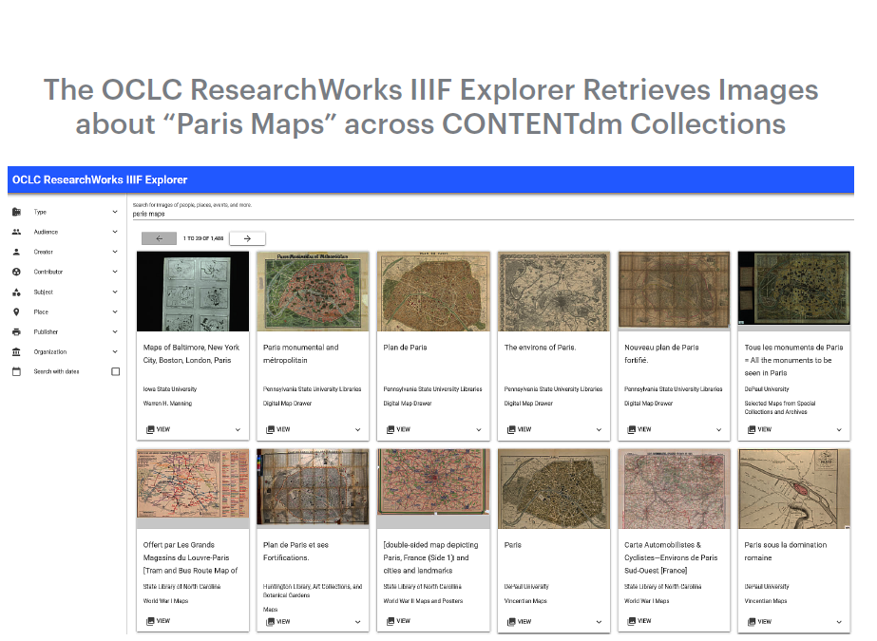
Describing “Inside-Out” and “Facilitated” Collections
Archival collections
Archived websites
Audio and video collections
Image collections
Research data
„Inside-Out“ & „Facilitated“ Collections
https://researchworks.oclc.org/iiif-explorer/
“Metadata underlies all discovery regardless of format, now and in the future…”
Notes:
The next section in the report focused on specific challenges in describing both “Inside-Out” collections, with the unique materials created and curated by institutions, as well as facilitated collections.
On the topic of “Inside-Out collections”, the Metadata Managers’ discussions always reflected the firm belief that “metadata underlies all discovery regardless of format, now and in the future”.
Discussions covered a number of formats such as
READ
CLICK
Discussions on the image collections provided an opportunity to showcase the OCLC ResearchWorks IIIF Explorer (International Image Interoperability Format) that allows people to retrieve images across different institutions and collections. And I encourage you to try it out, the link is shown on the slide.
More specifically on Research Data … CLICK

Slide 15
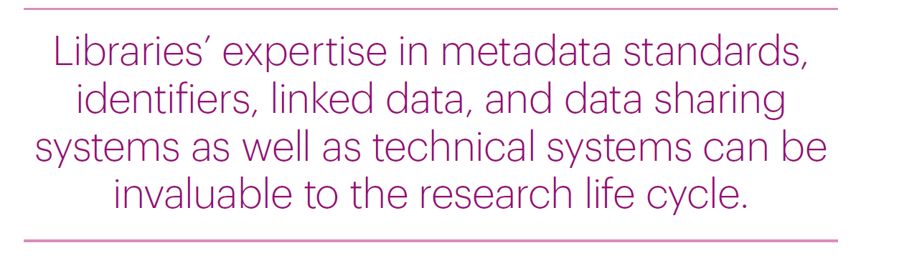
„Inside-Out“ & „Facilitated“ Collections
Notes:
Discussions revealted that libraries and esp. metadata specialists were often not included in the earliest stages of the research lifecycle.
However,
READ
So there clearly are challenges and opportunities here.

Slide 16

Access and quality
Quality of Shelf Ready Metadata
(NAG report)
National Bibliographic Knowledge Base (NBK)
„Inside-Out“ & „Facilitated“ Collections
Notes:
In providing access to facilitated collections we’re aware of the tension between timeliness and good quality description. Last summer the National Acquisitions Group in the UK prepared a report on the Quality of Shelf Ready metadata to encourage libraries and suppliers to work together to ensure fit for purpose metadata to support discovery and use. We also have a National Bibliographic Knowledgebase in the UK, which is a piece of national bibliographic data infrastructure which, among other things, supports us in shared cataloguing.

Slide 17


Plan M
“The changes in data availability, fitness-for-purpose (including eBook records) and coverage should start to enable libraries to regard the metadata associated with ‘routine acquisition’ as a solved issue, allowing them to focus on more bespoke work and describing special or hidden collections”
„Inside-Out“ & „Facilitated“ Collections
Notes:
The NBK supports the work of another UK wide project called Plan M, which stands for Plan Metadata, which is seeking to streamline the bibliographic ecosystem in the UK. It’s anticipated that an outcome of this will be that the metadata associated with ‘routine acquisition’ will be a solved issue, something we can buy in, without editing, allowing focus on metadata for our inside out collections.

Slide 18

Exposing unique content
Google Arts & Culture
Flickr
Unsplash
JSTOR Open Community Collections
„Inside-Out“ & „Facilitated“ Collections
Notes:
At LSE we’ve embarked on a piece of work I’ve called ‘Fit for Purpose metadata’ which looks, among other things, at how we can increase reliance on externally supplied records in order to create the capacity to engage with digital scholarship and linked data developments for our unique resources.
Colleagues in our Digital Library team have been pushing unique content to various platforms - Google Arts and Culture, Flickr, Unsplash and JSTOR Open Community Collections, and I’ve been looking at how we can link these external platform collections with the Library via Wikidata.

Slide 19

Working with unique content
Archives Hub Names Project
International Image Interoperability Framework (IIIF)
Text Encoding Initiative (TEI)
Metadata support for research data
„Inside-Out“ & „Facilitated“ Collections
Notes:
Working with unique content tends to mean we’re outside the realm of traditional library name authority files, and there’s a project being run by the Archives Hub, called the Names project, to explore how to process and match names to enable linking resources from different collections.
Unique content also often means we’re working with the different formats Karen’s highlighted. Jisc, who provide digital services and solutions to the UK Higher Education sector, recently worked with LSE and UCL to explore using IIIF to ease cataloguing issues and bottlenecks in digitisation projects. The University of Manchester have developed expertise with TEI for work with their digital collections to provide rich, contextual metadata.
Research data is an emerging area of involvement for metadata colleagues - during lockdown the metadata team at LSE have carried out an audit of LSE datasets in external repositories to support our Research Excellence Framework submission. Elsewhere metadata colleagues are sometimes involved in providing the metadata for internal research data repositories.

Slide 20
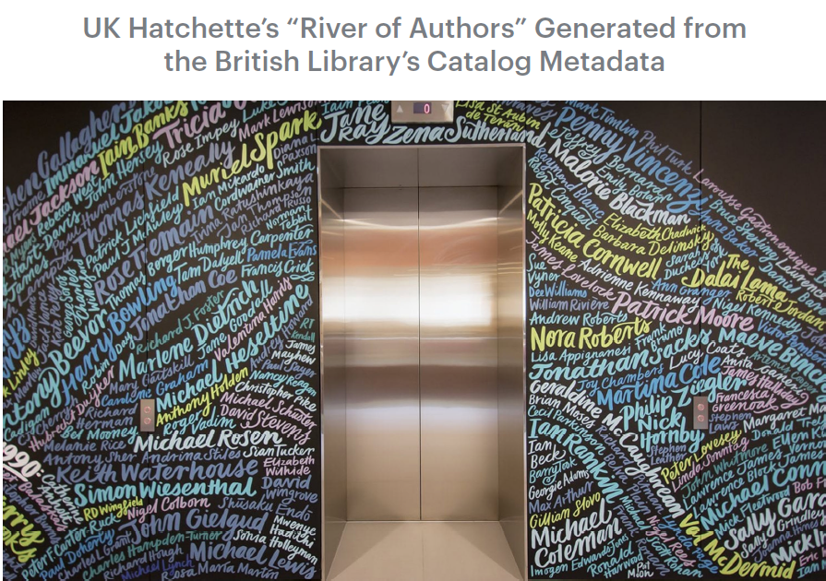
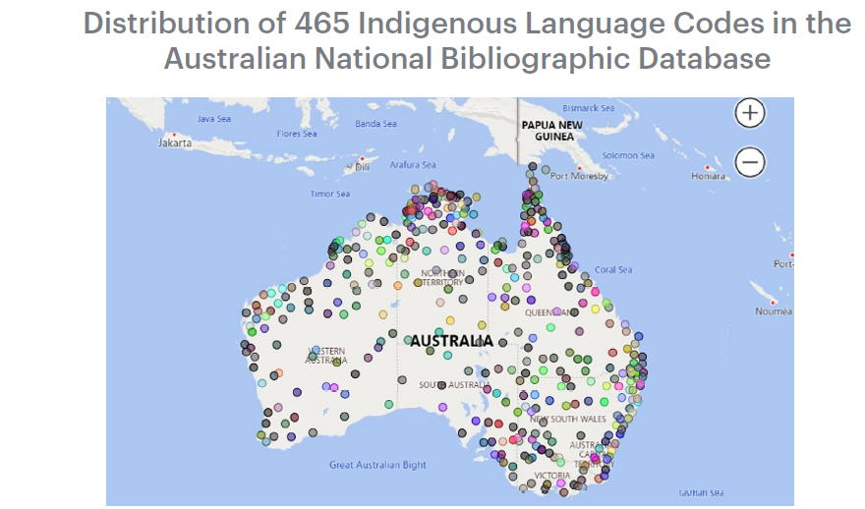
Evolution of “Metadata as a Service”
Metadata as a Service
New applications
Bibliometrics
Plus:
Metrics
Consultancy
Semantic indexing
Notes:
Metadata as a Service refers to uses of metadata beyond describing materials.
This can lead to the development of new applications, an example of which is given on the left hand side on the slide: A visualization of the distribution of Australian aboriginal languages as represented in the Australian National Bibliographic Database, drawn from the language codes assigned.
The photo on the right shows a decoration in the Hachette publisher group headquarters. The “River of authors”, as it is called, it based on bibliometrics supplied by the British Library on Hachette’s top authors represented in the BL’s catalog. Indeed a beautiful example of metadata visualization.
Metadata as a service can also include metrics, consultancy or semantic indexing.

Slide 21


Metadata as a service
Collaborative partnerships
Metadata as a primary output
Metadata as a Service
Notes:
The evolution of metadata as a service brings new opportunities for involvement and I think it’s important to be proactive in seeking those out.
Before lockdown I began a piece of work at LSE to review and reprioritise the work of the Metadata team to ensure we were supporting the changing needs of the library. As a result of this I’ve been seeking to reposition the team as a collaborative partner and also think about how we can establish metadata as a primary output in its own right, not simply as a supporting feature of other library services.

Slide 22

Cross team working
Research Support Digital Library
Data Management Plans JSTOR Open Community
Datasets audit Collections
REF support
Online services
Optimising library systems
Metadata as a Service
Notes:
Lockdown last year had an unexpected impact on this, but we were able to increase cross team working with the Research Support team, revive some involvement with Digital Library projects and plan work with the Online Services team as part of optimising library systems work.
Longer term I want us to look at collaborative partnerships to open up our metadata and expose it on the Web, and consider how collection metadata might be useful for research.

Slide 23

Catalogue as Data
Legacies of Catalogue
Descriptions and Curatorial Voice
Macroscopes and Microscopes:
Scholar Cyborgs in the Digital
Research Library
Metadata as a Service
Notes:
The idea of the catalogue as data is a culture shift we’re beginning to see more. James Baker, at the University of Sussex has blogged about the Legacies of Catalogue Descriptions project looking at computational, critical and curatorial analysis of collection catalogues.
And Tim Hitchcock, also from Sussex, gave a fascinating presentation at the Research Libraries UK 2019 conference about connecting scholars with bibliographic data for research.

Slide 24
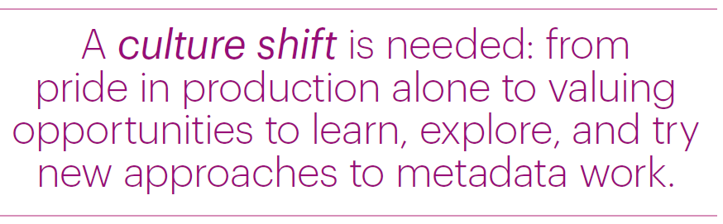
Preparing for Future Staffing Requirements
Future Staffing Requirements
Notes:
All these developments clearly have implications on the staffing requirements, and this generated lots of discussion among the Metadata Managers.
A culture shift is needed,
“from pride in production alone” – how many records you can produce in a single day or in a month -
“to valuing …” (READ)
Other subtopics in this realm are new tools and skills needed, self-education, and addressing staff turnover.

Slide 25


Culture shift
#RLUKdigishift
Future Staffing Requirements
Notes:
Research Libraries UK in particular have highlighted the culture shift we’re seeing through their Manifesto for the Digital Shift in research libraries, and their new Digital Shift Forum.

Slide 26
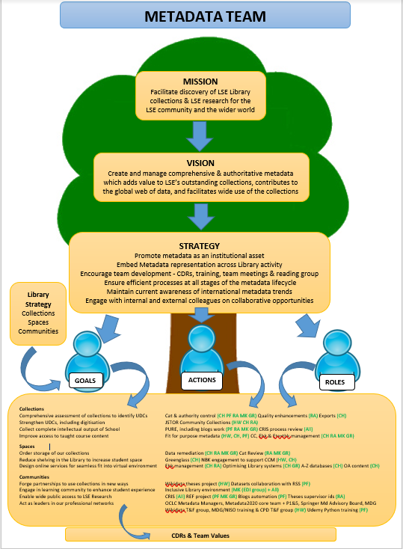
Metadata Team Purpose Tree
Future Staffing Requirements
Notes:
In this environment it’s vital not only to know, but to show how metadata links with and supports our library and institutional strategies – at LSE we do that through a team purpose tree which shows where our work fits into the library strategy, in turn informed by institutional strategy.

Slide 27

Flexibility
Seek opportunities for
Metadata colleagues
to contribute to the
wider work of the Library
Future Staffing Requirements
Notes:
Flexibility is absolutely key so that metadata colleagues can support the wider work of the library, and I try to see where our metadata expertise can be valuable to other work in the Library. During lockdown colleagues in the Metadata team at LSE were able to get involved in reviewing Data Management Plans and that’s enriched their work in the Metadata team by giving visibility of an earlier part of the research process when they’re used to working towards the end of it.

Slide 28

Reviews Efficiencies
New opportunities
Future Staffing Requirements
Experiments
Notes:
We also need to be prepared to carry out process reviews and seek out efficiencies. This year one of my team has been looking at how brief record rules in Alma, our Library Management System, might help us to spend less time reviewing metadata for teaching collections, and is hopeful we can shave 170 hours off the process a year. And we need to look at where we need new skills - another of my team is learning Python and has used new skills to further automate our blog metadata and some research support tasks. Time saved in the team is then repurposed to new and developmental work. My message as we navigate this culture shift in our libraries and transition to the next generation of metadata is don’t be afraid to experiment – that’s how we’ll learn and develop new skills to support our profession in the global sharing of data.

Slide 29


Conclusion
Notes:
The report concludes with the observation that READ.
The resulting impact will be global, affecting how librarians and archivists will describe the inside-out and facilitated collections, inspiring new offerings of “metadata as a service,” and influencing future staffing requirements.
At OCLC, work is underway to build a Shared Entity Management Infrastructure, and the Focus Group’s expectation is that it will address many of the challenges documented in the report around persistent identifiers, especially providing language-neutral links to trustworthy sources.
Another final key take-away from all the discussion was:
Good linked data requires good metadata!
So if you are a contributor to good metadata today, thank you for doing this, your efforts will greatly help create good linked data in the future.

Slide 30
The Transition to Linked Data and Identifiers
Describing “Inside-Out” and “Facilitated” Collections
Evolution of “Metadata as a Service”
Preparing for Future Staffing Requirements
Smith-Yoshimura, Karen. 2020. Transitioning to the Next Generation of Metadata. Dublin, OH: OCLC Research.
https://doi.org/10.25333/rqgd-b343
Notes:
This concludes our summary of key highlights from this extremely rich and informative report.
And as promised earlier:
Helen has done a marvellous job of pulling together all those references that we refer to during the presentation.
CLICK

Slide 31
Links to referenced articles, blogs, projects (1)
Slide 4
Smith-Yoshimura, Karen. 2020. Transitioning to the Next Generation of Metadata, Dublin, OH: OCLC https://doi.org/10.25333/rqgd-b343 (accessed 19th Oct 2020)
Slide 5
British Library. 2019. Foundations for the Future: The British Library’s Collection Metadata Strategy 2019-2023. London: British Library. https://www.bl.uk/bibliographic/pdfs/british-library-collection-metadata-strategy-2019-2023.pdf. (accessed 21st Oct 2020)
Slide 6
Aburrow-Jones, Natasha and Paul Cunnea. 2019. The Future of Cataloguing: A CIG Scotland World Café Workshop. Catalogue and Index (196). pp. 27-33. https://cdn.ymaws.com/www.cilip.org.uk/resource/collection/0E92069B-94A5-4749-B3E3-A32037C69EE7/ci_196_aburrow-jones_cunnea_future_cataloguing.pdf (accessed 21st Oct 2020)

Slide 32
Links to referenced articles, blogs, projects (2)
Slide 10
Smith-Yoshimura, Karen. 2020. Transitioning to the Next Generation of Metadata, Dublin, OH: OCLC Research, p12. https://doi.org/10.25333/rqgd-b343 (accessed 19th Oct 2020)
Book Industry Communication. 2020. BIC Metadata Map. https://www.bic.org.uk/195/BIC-Metadata-Map/ (accessed 9th Nov 2020)
Slide 11
Towards a National Collection https://www.nationalcollection.org.uk/ (accessed 19th October 2020)
Persistent Identifiers as IRO infrastructure https://www.nationalcollection.org.uk/projects (accessed 19th October 2020)
FREYA https://www.project-freya.eu/en (accessed 19th Oct 2020)

Slide 33
Links to referenced articles, blogs, projects (3)
Slide 12
Evans, Jason. 2020. Creating and Enriching Linked Data with Wikidata. CILIP Metadata & Discovery Group conference 2020. https://www.youtube.com/watch?v=RApW2x4KJfw (accessed 19th Oct 2020)
Poulter, Martin. 2019. Wikidata: GLAM/Oxford. Wikidata. https://www.wikidata.org/wiki/Wikidata:GLAM/Oxford (accessed 19th Oct 2020)
Poulter, Martin and Nick Sheppard. 2020. Wikimedia and Universities: Contributing to the Global Commons in the Age of Disinformation. Insights 33 (1): 14. http://doi.org/10.1629/uksg.509 (accessed 19th Oct 2020)
Sheppard, Nick. 2019. Wikimedia in Universities. Leeds University Library blog, 1 Feb 2019. https://leedsunilibrary.wordpress.com/2019/02/01/wikimedia-in-universities/ (accessed 19th Oct 2020)
Wikimedia UK and the University of Edinburgh. 2020. Wikimedia in Education. https://open.ed.ac.uk/wikimedia-in-education/ (accessed 19th October 2020)
Pim, Harrison. 2020. Concepts, Wikidata etc. Wikidata and Cultural Heritage Collections, Science Museum Heritage Connector webinar. 19th Jun 2020. https://www.youtube.com/watch?v=kZGcnL8gI6Y (accessed 19th Oct 2020)

Slide 34
Links to referenced articles, blogs, projects (4)
Slide 13
IFLA. 2020. WikiCite Discussion Series. https://www.youtube.com/playlist?list=PLV81siTMahbsjakNDIdFwbIvdyNqwRNPo (accessed 19th Oct 2020)
Cataloging Ethics Steering Committee. A code of ethics for catalogers. https://sites.google.com/view/cataloging-ethics/home (accessed 19th Oct 2020)
Slide 16
Booth, Emma. 2020. Quality of Shelf-Ready Metadata: Analysis of Survey Responses and Recommendations for Suppliers. National Acquisitions Group. https://nag.org.uk/wp-content/uploads/2020/06/NAG-Quality-of-Shelf-Ready-Metadata-Survey-Analysis-and-Recommendations_FINAL_June2020.pdf (accessed 19th Oct 2020)
Grindley, Neil. 2019. Driving Transformation with the NBK – where have we got to and where next? Jisc. https://libraryservices.jiscinvolve.org/wp/2019/01/nbktransformation/ (accessed 19th Oct 2020)

Slide 35
Links to referenced articles, blogs, projects (5)
Slide 17
Grindley, Neil. 2019. Plan M – definition and direction. Jisc. p4. https://libraryservices.jiscinvolve.org/wp/2019/12/plan-m/ (accessed 19th Oct 2020)
Slide 18
LSE Library on Google Arts & Culture https://artsandculture.google.com/partner/lse-library (accessed 19th Oct 2020)
LSE Library on Flickr https://www.flickr.com/photos/lselibrary/ (accessed 19th Oct 2020)
LSE Library on Unsplash https://unsplash.com/@londonschoolofeconomics (accessed 19th Oct 2020)
LSE Library on JSTOR Open Community Collections https://www.jstor.org/site/london-school-of-economics/ (accessed 26th Oct 2020)
Slide 19
Stevenson, Jane. 2020, Names Project. Archives Hub. Jisc. https://blog.archiveshub.jisc.ac.uk/category/names-project/ (accessed 21st Oct 2020)
Findlay, Peter. 2019. Changing Digital Workflows with IIIF and Semantic Web Tools (report). Jisc. https://digitisation.jiscinvolve.org/wp/2019/12/04/changing-digital-worksflows-with-iiif-and-semantic-tools-report/ (accessed 19th Oct 2020)

Slide 36
Links to referenced articles, blogs, projects (6)
Slide 23
Baker, James.2020. Legacies of Catalogue Descriptions and Curatorial Voice: Opportunities for Digital Scholarship. https://cataloguelegacies.github.io/ (accessed 19th Oct 2020)
Hitchcock, Tim. 2019. Macroscopes & Microscopes: Scholar Cyborgs in the Digital Research Library. RLUK conference 2019. https://www.rluk.ac.uk/rlukplayer/ (accessed 19th Oct 2020)
Slide 25
RLUK. 2020. Digital Shift. https://www.rluk.ac.uk/digital-shift/ (accessed 19th Oct 2020)
Slide 26
Purpose Tree Model adapted from a diagram used by Tim Fuller of The Reality Business on LSE Introduction to Leadership Programme. http://www.realitybusiness.co.uk/the-team/ (accessed 11th Nov 2020)
Slide 29
OCLC Shared entity management infrastructure. https://www.oclc.org/en/worldcat/oclc-and-linked-data/shared-entity-management-infrastructure.html (accessed 9th Dec 2020)

Slide 37
Links to referenced articles, blogs, projects (7)
Photo credits
Slide 3, top left, Karen Smith-Yoshimura
Slide 3, top right, Spekking, Raimond (2018), 28 Nov. Available at https://twitter.com/Raymond_de (accessed 8th Dec 2020)
Slide 3, bottom left, Carey Champieux
Slides 6, 10-13, 16, 17, 19, 21-23, 27, 28, CC0, 3dman: Pixabay
Slide 25, RLUK CC BY-NC-SA 4.0
Slide 26, Helen Williams

Slide 38


Transitioning to the Next Transitioning to the Next Generation of Metadata January 2021
Thank you!
Contacts:
Annette Dortmund
Annette.Dortmund@oclc.org
@libsun
Helen K. R. Williams
H.K.Williams@lse.ac.uk
@HelsKRW
Notes:
So thank you for your attention – and now we should have some time for questions or discussion. We would love to hear what you think, and in how far what Helen talked about specifically resonates with you here in your different regional settings.

Slide 39
OCLC RLP Metadata Managers Focus Group – Report fodder
62
Partners in 11 countries
777
Pages of response compilations
93
Hours of discussion
Notes:
So let me give you some background on this group, the OCLC Research Library Partners Metadata Managers Focus Group, since it was the interactions with this group that provided the fodder for the report.
The FG itself has representatives from 62 research institutions, from 11 countries, spanning four continents.
Every year the FG members were asked to respond to a set of question sets. Over the last 6 years covered in the report, 2015-2020, if you compiled all of those responses, it came to 777 pages (and yes, Karen counted them). These compilations served as the basis of discussions with the FG, altogether 93 hours of discussions.
My co-presenter today, Helen, was one of the Focus Group members, one of the people who contributed to the 777 pages and contributed to some of those discussions.

Slide 40
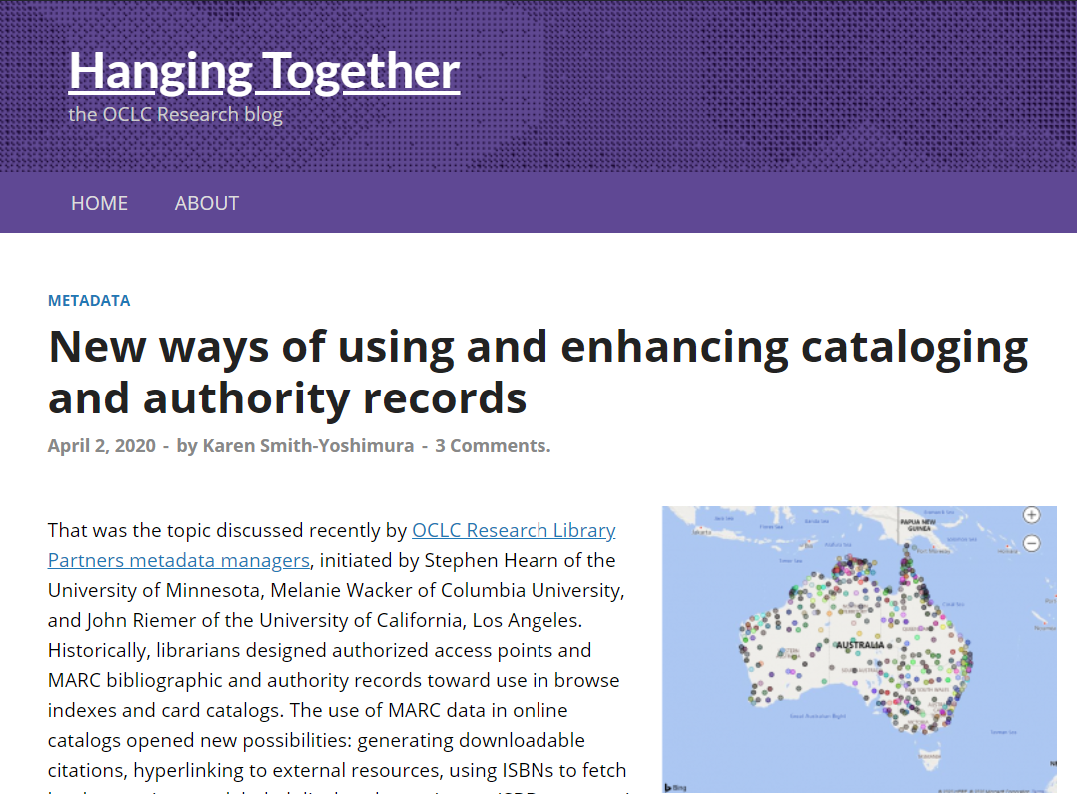
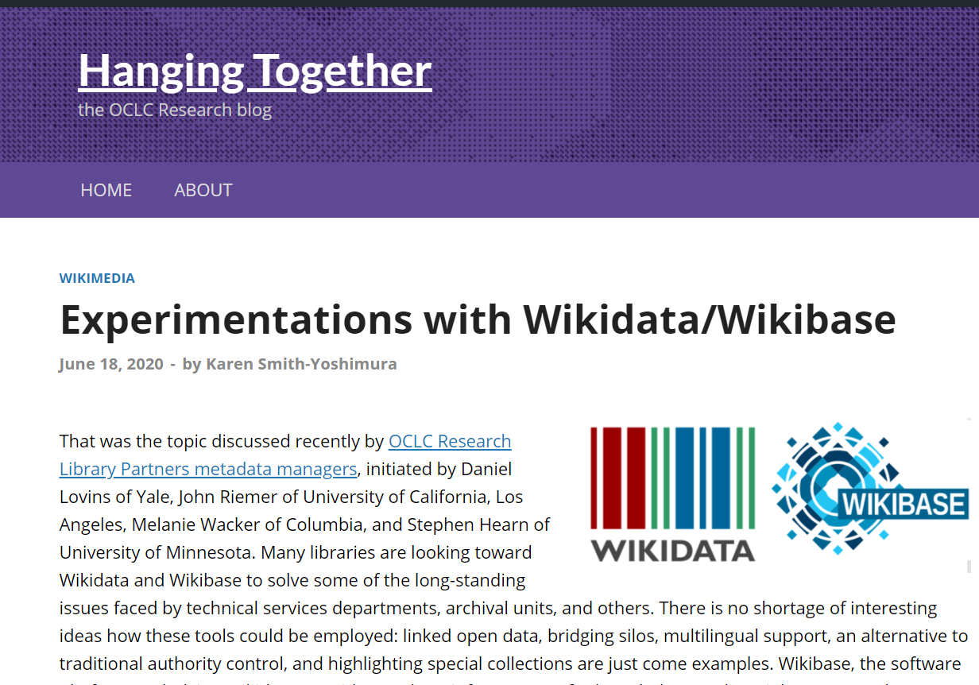
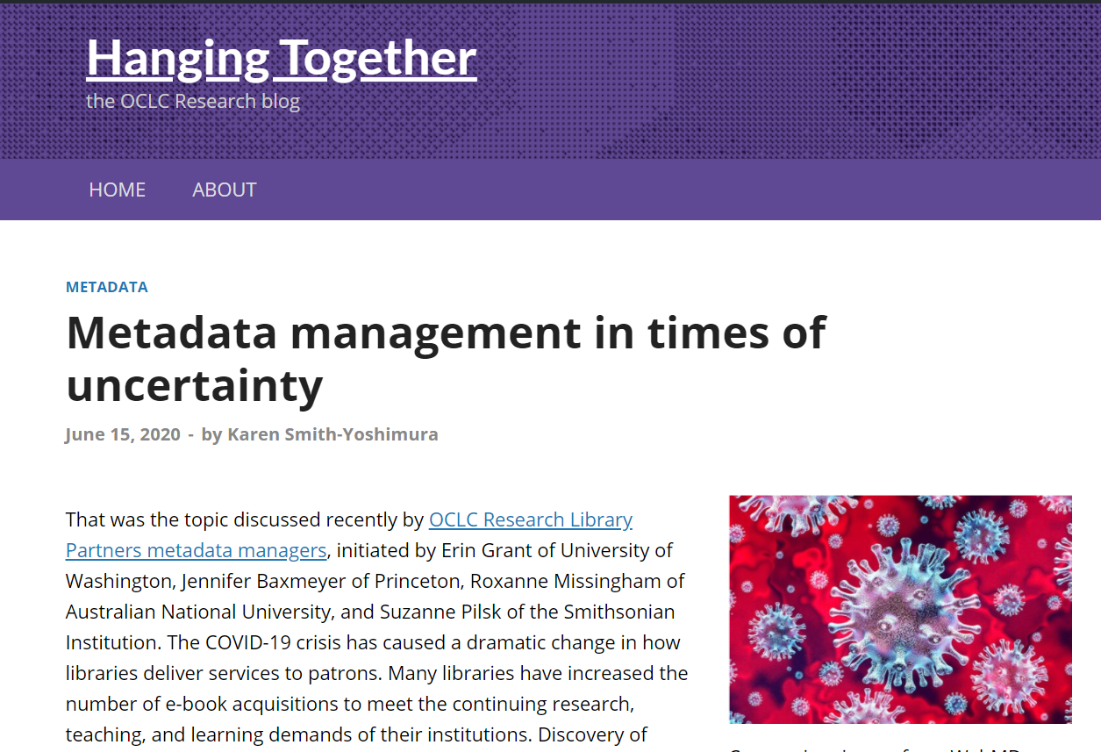
36 HangingTogether Blog Posts summarizing discussions
https://hangingtogether.org/
Notes:
ALL of the discussions were summarized in a OCLC Research HangingTogether blog post, a total of 36 of them in this six-year period.

Slide 41
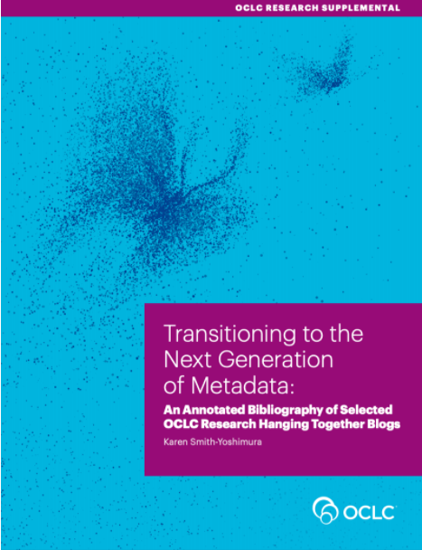
Supplement
https://oc.lc/nextgen-metadata-report
Notes:
Just a note: OCLC also published as a supplementary document to the report an annotated bibliography of all the HangingTogether blog posts cited in the report, organized to mirror the sections of the report, and providing more details on each blog post.

